Slide 1
Sleep: The Force Multiplier
Tracy Jill Doty, PhD
Chief of Operations, Sleep Research Center
Behavioral Biology Branch
Walter Reed Army Institute of Research (WRAIR)
19 MAY 2022

Slide 2
Disclaimer
Material has been reviewed by the Walter Reed Army Institute of Research. There is no objection to its presentation and/or publication. The opinions or assertions contained herein are the private views of the author, and are not to be construed as official, or as reflecting true views of the Department of the Army or the Department of Defense. The investigators have adhered to the policies for protection of human subjects as prescribed in AR 70-25.

Slide 3
Outline
Prevalence of Sleep Loss
Consequence of Sleep Loss
Introduction to the WRAIR Sleep Research Center (SRC)
What is it like to be a research subject at the SRC?
Recruitment call!

Slide 4
How many hours of sleep a night does an adult need to be healthy according to the National Sleep Foundation?
  7 or more hours
How many Americans do not get enough sleep?
  Over 1/3 of American adults get less than 7 hours a night

Slide 5
Sleep Loss in the Military
Amount of sleep needed to be healthy according to National Sleep Foundation
2/3 of the military do not get enough sleep – this is double that of the civilian population

Slide 6
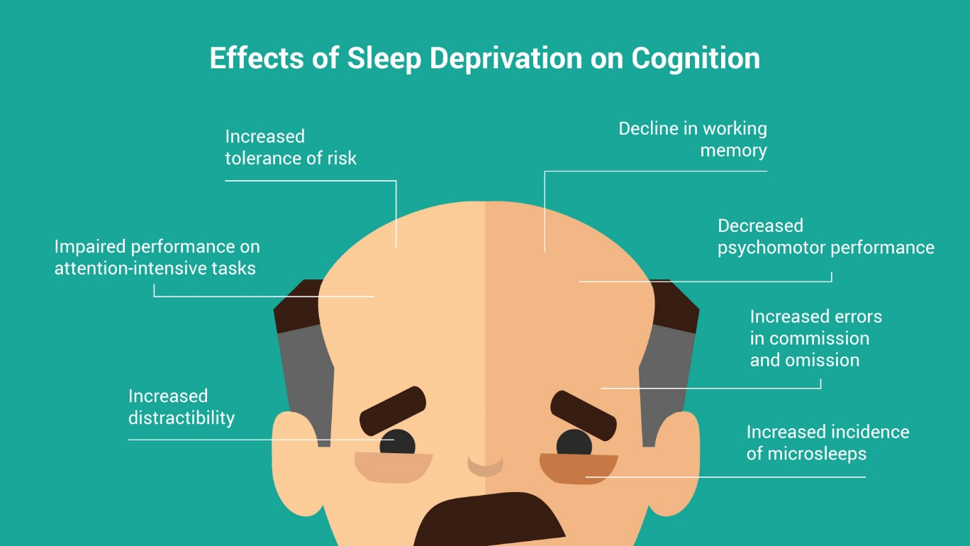
Why Does Sleep Matter?
Negative Mood
Weakened Immune System
Chronic sleep loss linked to many disorders (mood disorders, diabetes, obesity, heart disease, cancer….)
Sleep loss impacts everything we take for granted about being healthy !
https://www.myempro.com/education/consequences-of-sleep-deprivation-on-physicians

Slide 7
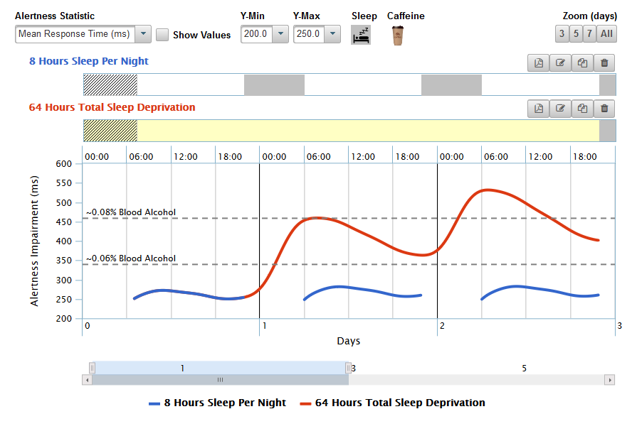

Impact of Sleep Loss on Performance
https://sleep.bhsai.org/
Get performance estimates for any sleep/caffeine schedules
  Download min-to-min performance predictions
Get caffeine timing and dosage recommendations for future peak alertness
Just one night of not sleeping makes someone perform as poorly the next morning as being legally drunk (and this assumes the person normally sleeps 8 hours a night!!!)

Slide 8
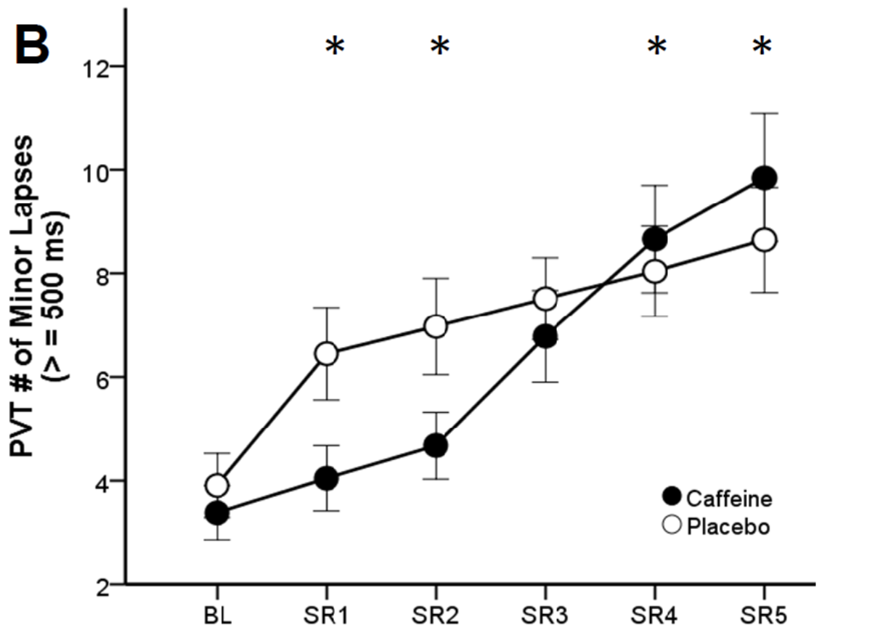
Can Interventions Prevent Sleep Loss Related Performance Declines?
400 mg of caffeine a day kept performance sustained for two days of chronic sleep restriction (5 hours sleep a night)
But its effect was lost after the third night of sleep restriction. Thereafter, caffeine was no better than placebo
More than 400 mg/day may help but negative side effects increase (jitteriness, anxiety)
The same dose of caffeine stops working after 3 nights of sleeping 5 hours a night !
Doty TJ et al (2017). Limited Efficacy of Caffeine and Recovery Costs During and Following 5 Days of Chronic Sleep Restriction. Sleep. Dec 1;40(12).

Slide 9
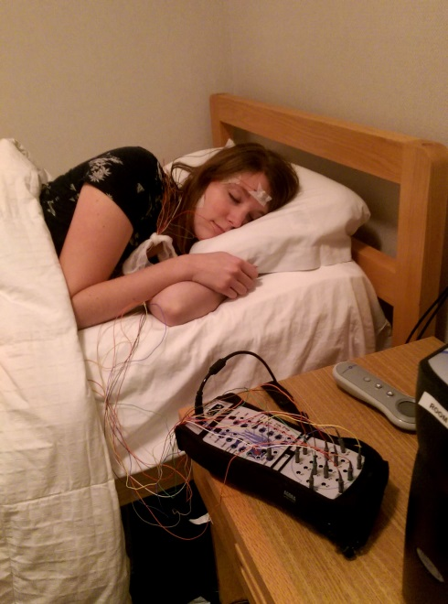

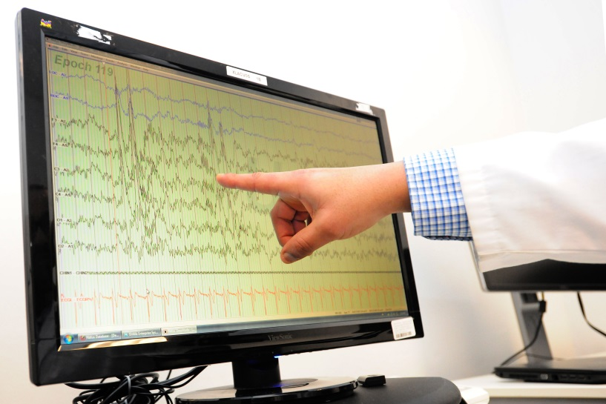



The DoD’s Premier Sleep Laboratory
OUR MISSION
The exploration and development of strategies and technologies for monitoring, preventing, and/or reversing the decrementing effects of sleep loss, stress, and fatigue on cognitive performance to enhance Warfighter operational judgment and decision-making.

Slide 10
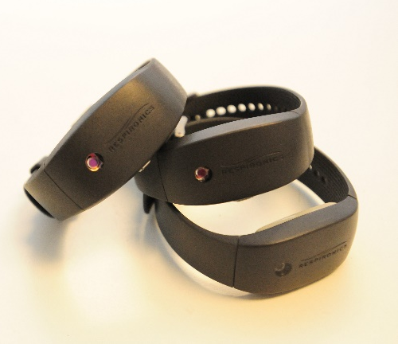
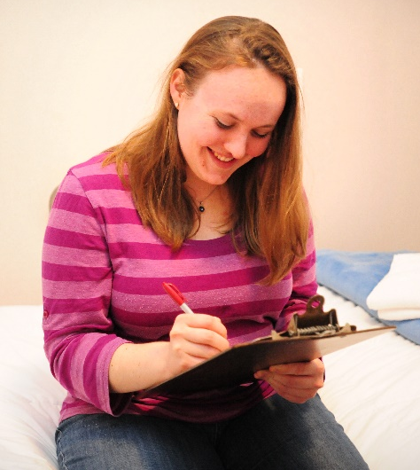
What is it like to be a research subject at the SRC?
Step 1 – Phone Screen (<5 min)
Step 2 – In Person Screen (~3 hours)
Step 3 – Enrollment day (~3 hours)
Step 4 – Wear actigraph (sleep watch) while doing normal activities (1-2 weeks)
Step 5 – Come in house for study (5-45 days)
Common exclusionary criteria - <18 or >40 years old, sleep too little or too much, medical conditions, BMI >30

Slide 11
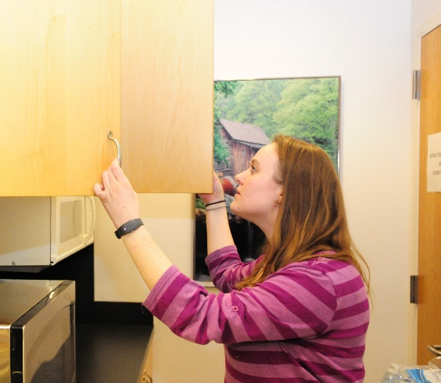
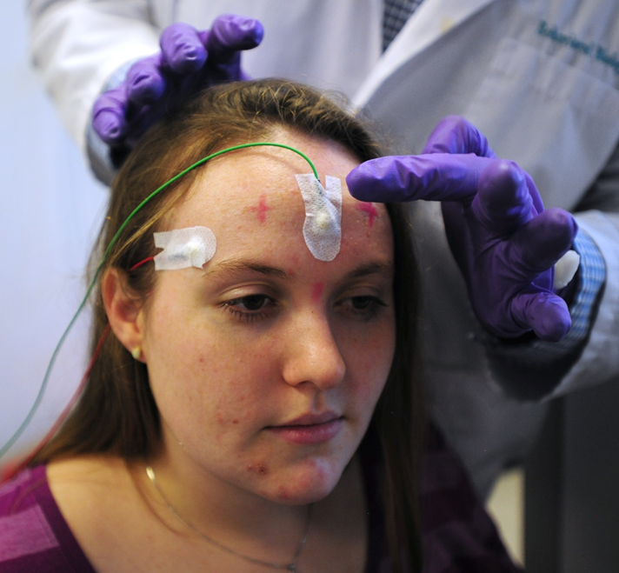
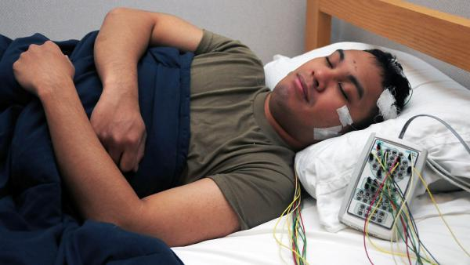

What is it like to be a research subject at the SRC?
Sample schedule while in house for a study:
  Day 1
    7am – Wake up after sleeping in the lab overnight
    7:30am – Vitals signs taken
    8:00-8:30am – Testing block at computer
    Testing blocks continue every 75 minutes
    9pm – Apply stimulation electrodes
    11pm-1am – Sleep and receive electrical stimulation or sham
  Day 2
    1am – Remove stimulation electrodes
    2:30am – Testing block at computer
    Testing blocks continue every 75 minutes for next 45 hours

Slide 12
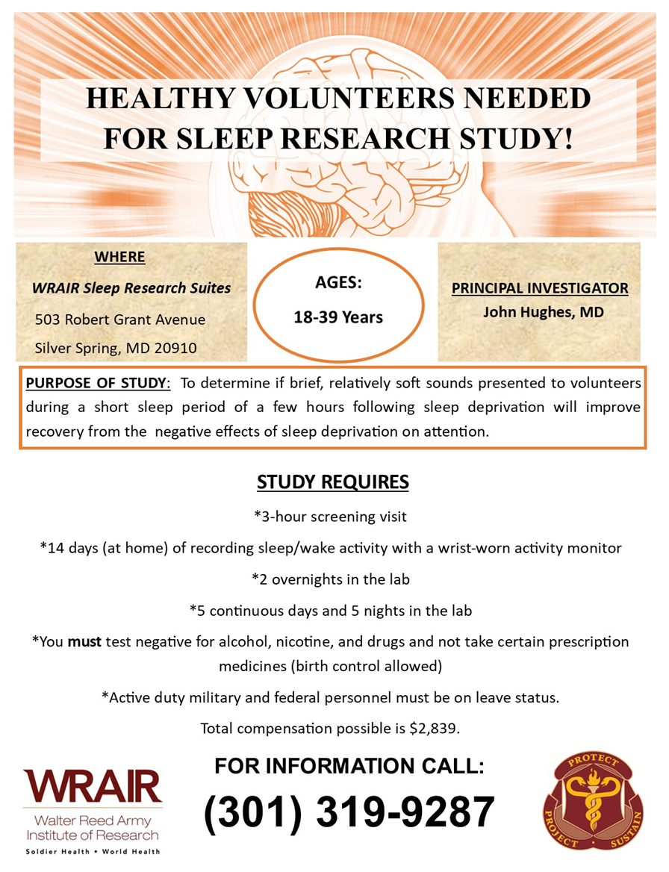
CURRENTLY RECRUITING!
WRAIR #2901 – Acoustic Stimulation with Sleep Loss
←-------------------------------
WRAIR #2262 – Transcranial Electrical Stimulation during Sleep with Sleep Loss
WRAIR #2852 – Transcranial Electrical Stimulation during Wake with Sleep Loss
Other upcoming studies – brain imaging and chronic sleep restriction, napping strategies, sleep drug comparison

Slide 13
THANK YOU!!!
Questions?
RESOURCES
Our recruitment page is now at – https://wrair.health.mil/Join-a-Study/Sleep-Research-Center/
Our resource page is now at – https://wrair.health.mil/Biomedical-Research/Center-for-Military-Psychiatry-and-Neuroscience/CMPN-Training-Products/
Performance Prediction Algorithm – https://sleep.bhsai.org/

