Slide 1
Walter Reed Army Institute of Research (WRAIR): 130 Years of Research for Military and Global Health
Dr. Debra Yourick
Director, Science Education and Fellowship Programs
Walter Reed Army Institute of Research
Debra.l.Yourick.civ@health.mil
Material has been reviewed by the Walter Reed Army Institute of Research. There is no objection to its presentation and/or publication. The opinions or assertions contained herein are the private views of the author, and are not to be construed as official, or as reflecting true views of the Department of the Army or the Department of Defense.

Slide 2
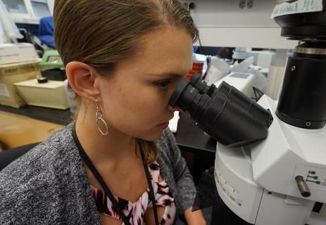
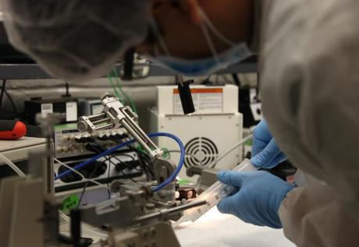
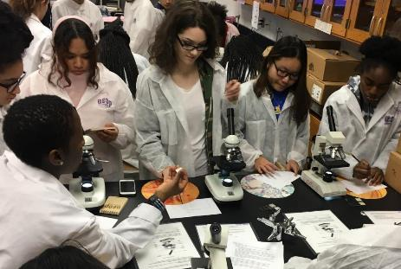
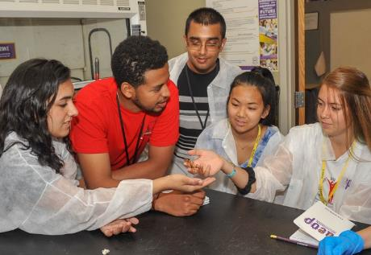
WRAIR Missions
Fighting infectious disease
SARSCoV/MERS, multidrug resistant bacteria, Zika, Ebola, malaria, dengue, influenza and more
Promoting brain health
Sleep, neuroprotection, and means to address combat stress and PTSD
Enabling product development
Expanding the STEM workforce

Slide 3
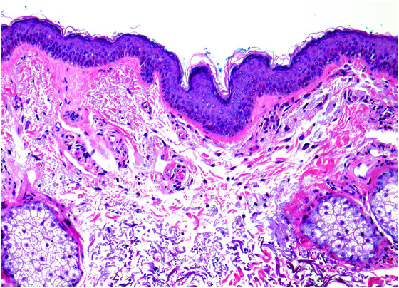
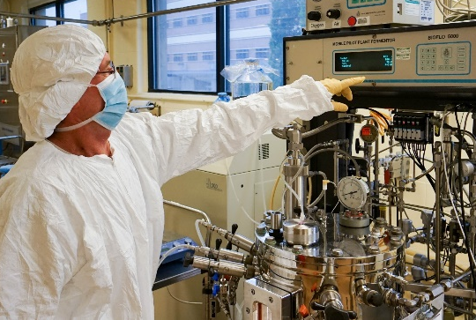
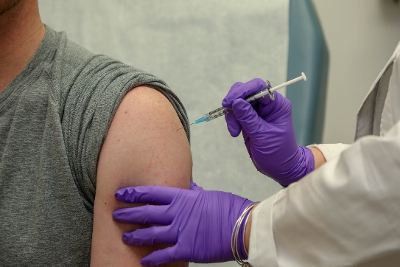
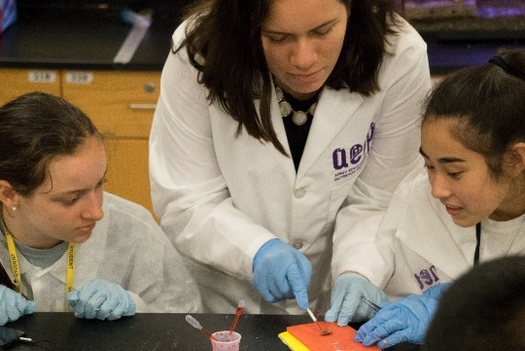
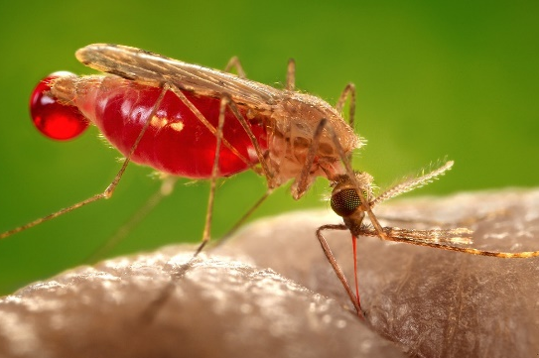
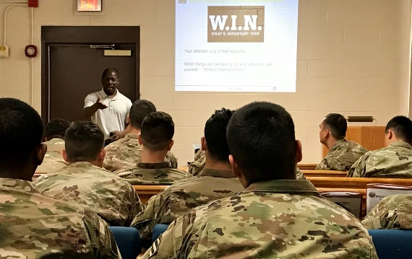
Enabling Better Outcomes in Research
Bioproduction Capability
Clinical Trials Center
Veterinary Support Services
Educational Programs
Entomology
Research Transition Office

Slide 4
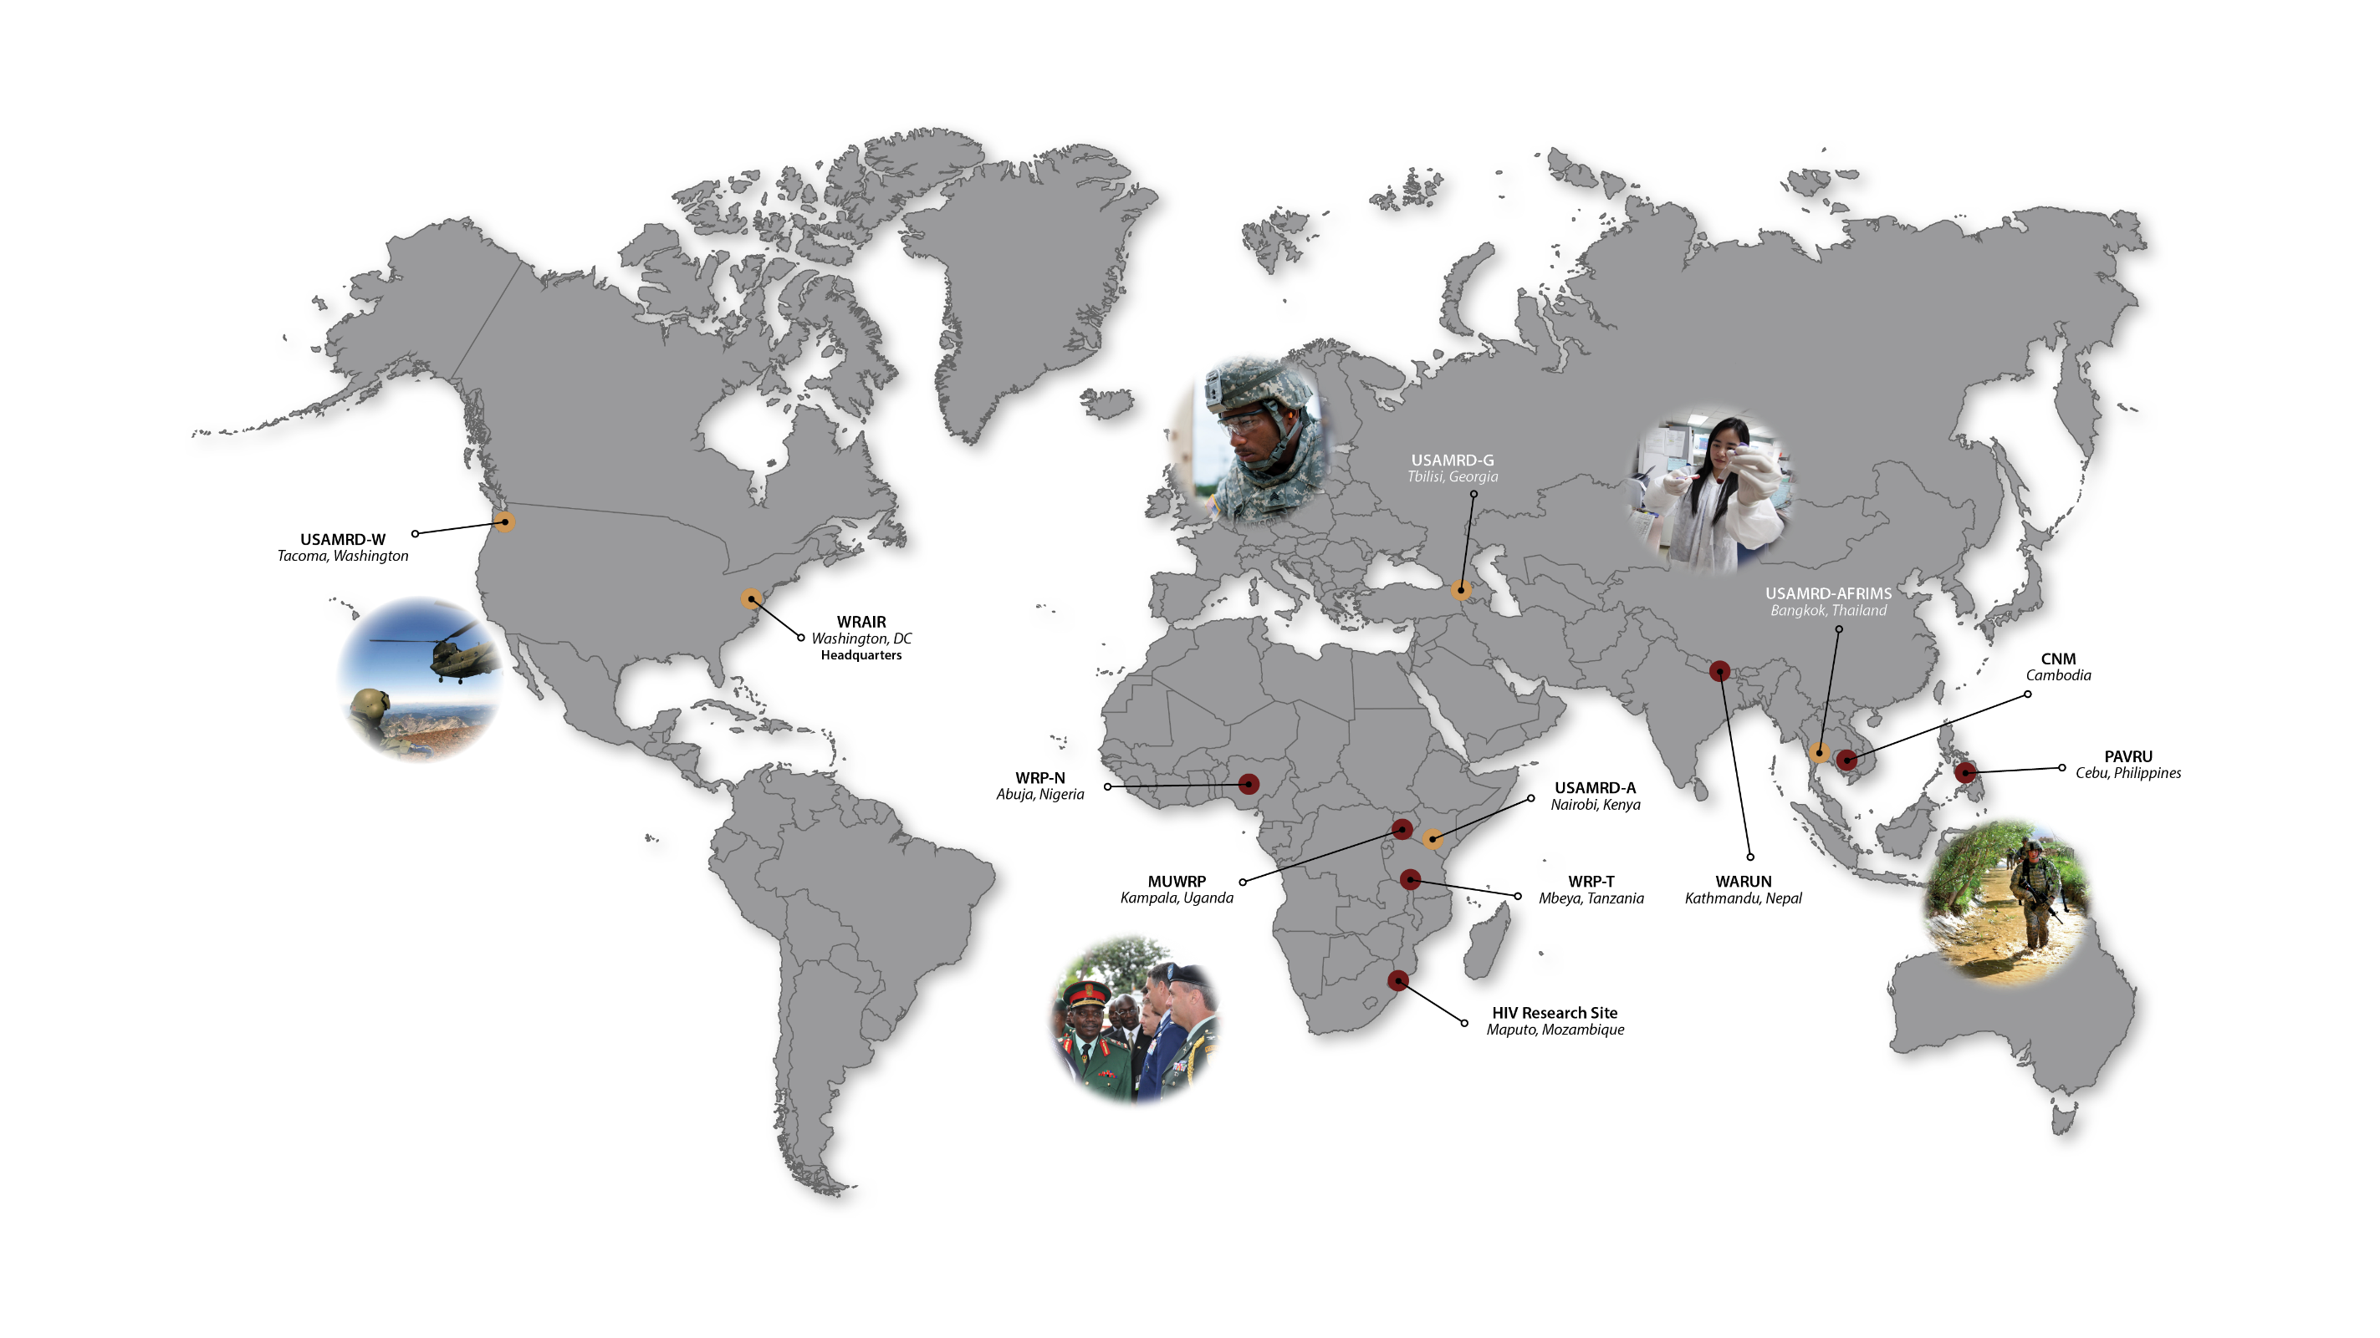
Global Enterprise

Slide 5
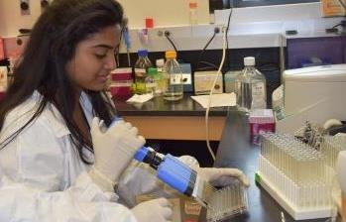
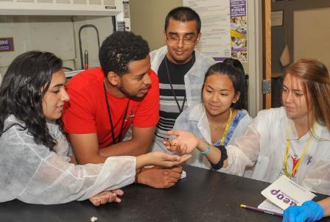
Access to Quality STEM Experiences for All
US Army Educational Outreach Program (USAEOP.com)
to Expand Diversity, Equity and Inclusion
Gains in the Education of Mathematics & Science (GEMS, USAEOP.com)
Beginning (7th–8th); Intermediate (9th–10th); Advanced (11th–12th)*
Diverse Program with Access for the Underserved; 10, one-week programs each summer
High School Apprenticeship Program (HSAP, USAEOP.com)
Eight weeks during the summer in a mentor’s laboratory
Undergraduate Research Apprenticeship Program (URAP, USAEOP.com)
Ten weeks during the summer in a mentor’s laboratory
Fellowships for post-baccalaureates*/-masters/-doc, graduate students (contact me or my staff)
*New National Defense Education Program (NDEP) grant supports HBCU fellows or participate in WRAIR labs and later train Advanced GEMS grads
Notes:
How do we try to contribute toward this mission? …

