Slide 1
Mindfulness: Training Your Mind to Boost Resilience
MAJ Thomas Nassif
Research Psychologist
Behavioral Biology Branch
Walter Reed Army Institute of Research
20 July 2023

Slide 2
Disclaimer
Material has been reviewed by the Walter Reed Army Institute of Research. There is no objection to its presentation and/or publication. The opinions or assertions contained herein are the private views of the author, and are not to be construed as official, or as reflecting true views of the Department of the Army or the Department of Defense.
The investigators have adhered to the policies for protection of human subjects as prescribed in AR 70-25.

Slide 3
Past, Present, or In the Moment?
The mind is often in fast-forward with future directed planning, worry, or catastrophizing … or in the past, ruminating, reliving or regretting.
Mindfulness is about holding steady on ‘play’ to experience events in the present moment with clarity and calmness.
-Dr. Amishi Jha

Slide 4

Baseline Assessment
On a scale of 1 to 10, rate your level of stress
Note what’s coming up for you… thoughts, feelings, sensations
Are they pleasant, unpleasant, or neutral?

Slide 5

Try this Focused Attention Practice
Count your breaths from 7 to 1 – if you get distracted, begin again at 7
Explore where you feel the breath most—for example it could be your nostrils, your chest, or your shoulders
Select the area that you are most drawn to and let that be the focus of your attention
Notice when your mind wanders away from this target—and when it does—gently bring it back to the sensation

Slide 6

Try this Open Monitoring Practice
Expand awareness beyond the body to your surroundings… sounds, smells, the touch of air on your skin, light trickling through the eyelids
Notice when your mind wanders to a thought, feeling, or sensation – note if it’s pleasant, unpleasant, or neutral
Bring your attention back to the present, observing with your senses
Feel yourself to be unchanging and timeless awareness—even as things come and go around you

Slide 7

Post Assessment
On a scale of 1 to 10, rate your level of stress
Note what’s coming up for you… thoughts, feelings, sensations
Are they pleasant, unpleasant, or neutral?
If you could describe your experience with this mindfulness practice in one word, what would it be?

Slide 8
Striking a Balance
Mindfulness goes beyond directing our attention to the breath, body, or senses
One must also monitor the quality of attention
During mindfulness practice, notice if your mind tends to fall into excitation/excitation or laxity/boredom?
Agitation/Excitation
Quality of Attention
Optimal Activation
Laxity/Boredom
Meditation Time Interval
8

Slide 9
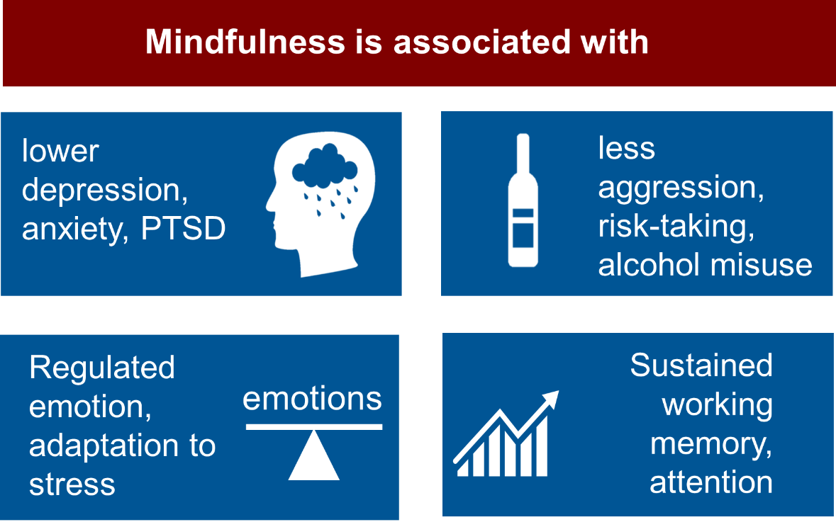
Research on Mindfulness

Slide 10
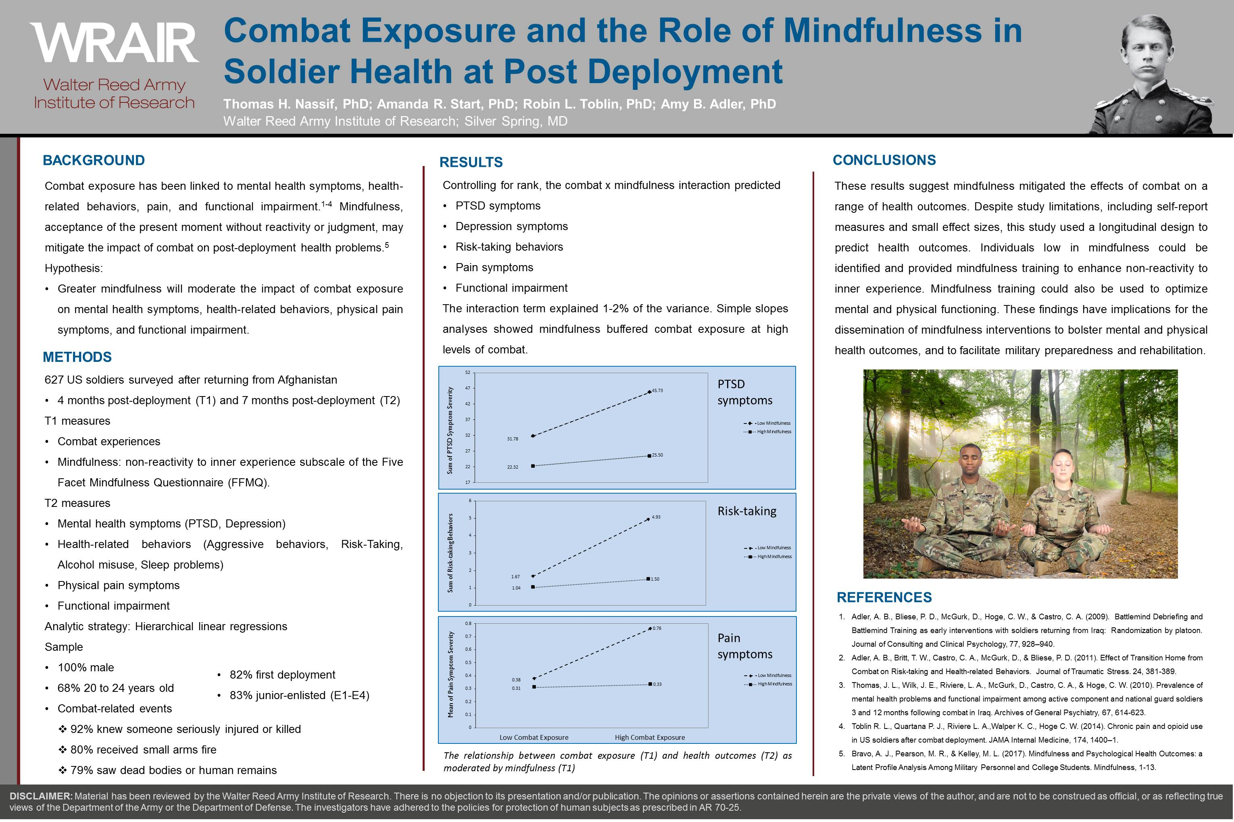

Slide 11
Broad Categories of Meditation
Focused Attention (FA) | Open Monitoring (OM)
Sustain attention on a specific object such as the breath, body, image, or mantra | Monitor the spontaneous flow of cognitive and emotional patterns without judgment
Foster mental focus and stability, decrease mind wandering | Gain insight about nature of mental patterns, cultivate nonreactivity
Metta, Lovingkindness, Trataka, Transcendental Meditation | Vipassana, Insight, Mindfulness, Zen, MBSR, MBAT, IBMT
Broad
Narrow

Slide 12
Mindfulness-Based Attention Training (MBAT)
Focus of Psycho-Educational Content | Formal Practices | Embedded Practices for “In-the-Moment”
Enhance concentration, focused attention, and brain fitness | Concentration (on Breath) | Mind at Attention
Sustain attention on the body with nonjudgmental awareness | Body Scan | Mind at Rest
Foster situational awareness by observing sensory and mental experiences | Open Monitoring | Mind at Ease
Develop team cohesion by offering positive statements to self and others | Connection | One Breath Connect

Slide 13
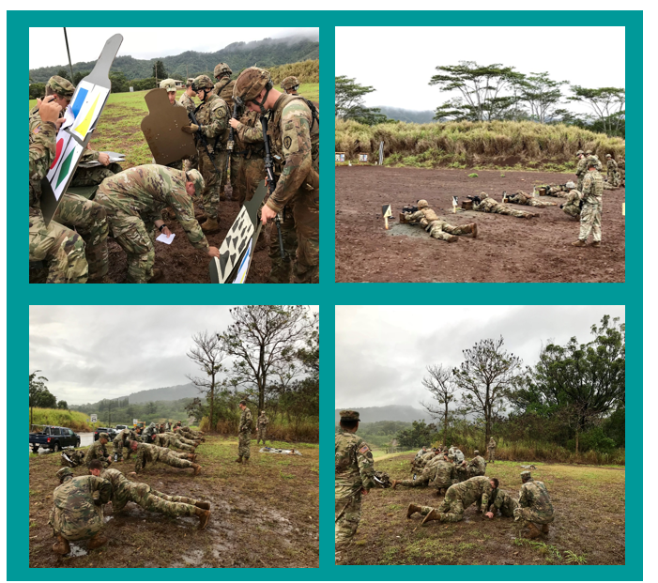
Mindfulness Operational Outcomes Study
Nassif et al. (2021) in Military Medicine
CUI
13

Slide 14
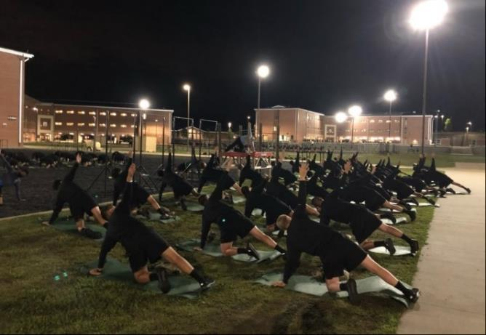
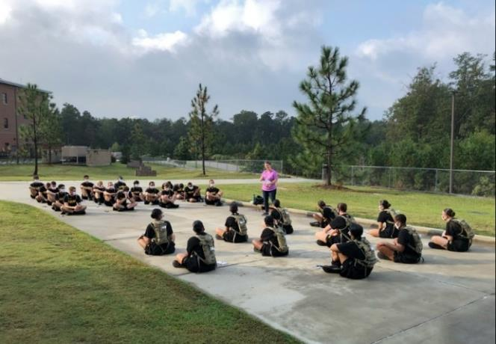
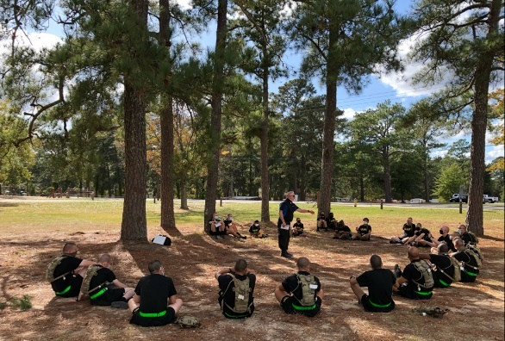
Mindfulness and Yoga in Basic Combat Training
CUI

Slide 15
Study Design
T1
survey
40 platoons
(N = 1895)
Mindfulness & Yoga (M&Y)
20 platoons
T2
survey
T3
survey
T4 survey
T5
survey
Training As Usual (TAU)
20 platoons
6-12 Months
Post-BCT
Baseline
Follow-up
9-10 Weeks

Slide 16
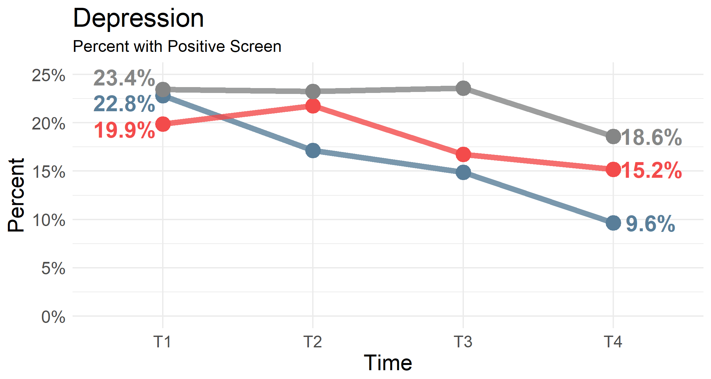
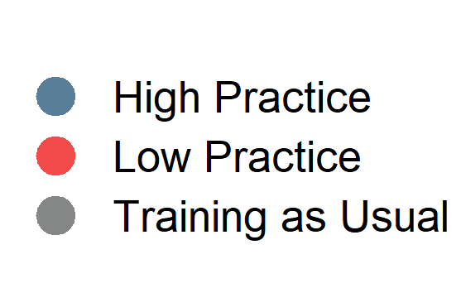
Mental Health
  Note: Practice level defined by trainees’ reported level of practice at T4
  *Also significant differences by training condition regardless of individual practice frequency.

Slide 17
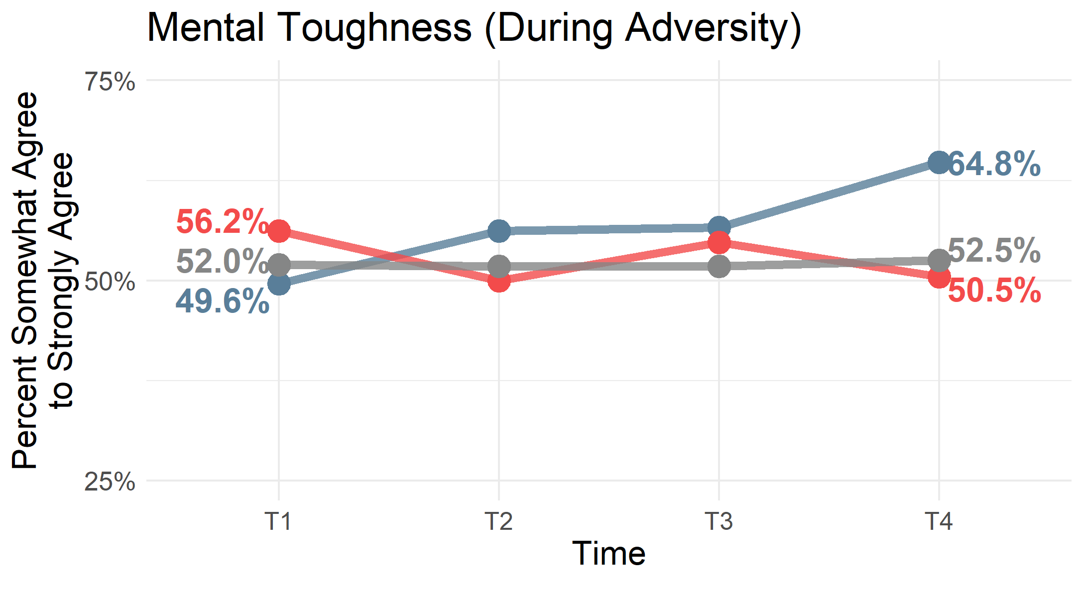
Mental Resilience
  Note: Practice level defined by trainees’ reported level of practice at T4.

Slide 18
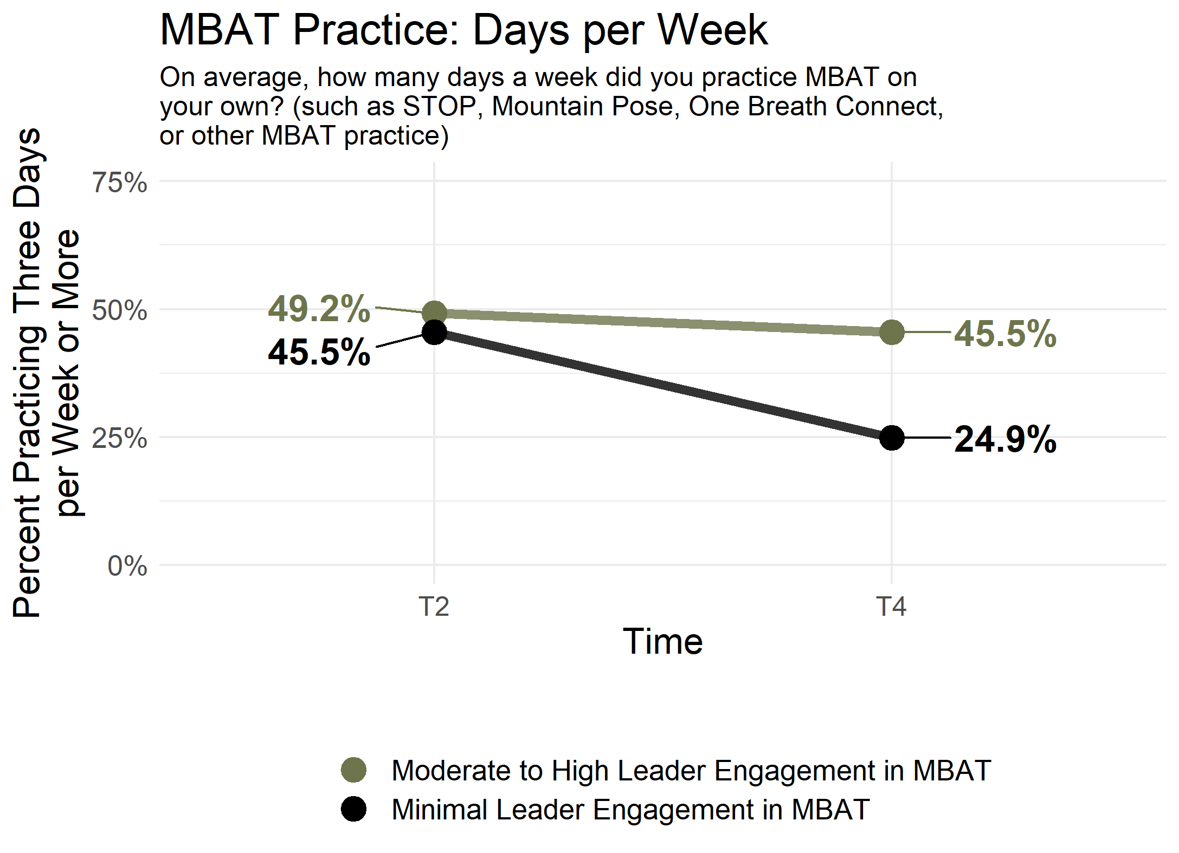
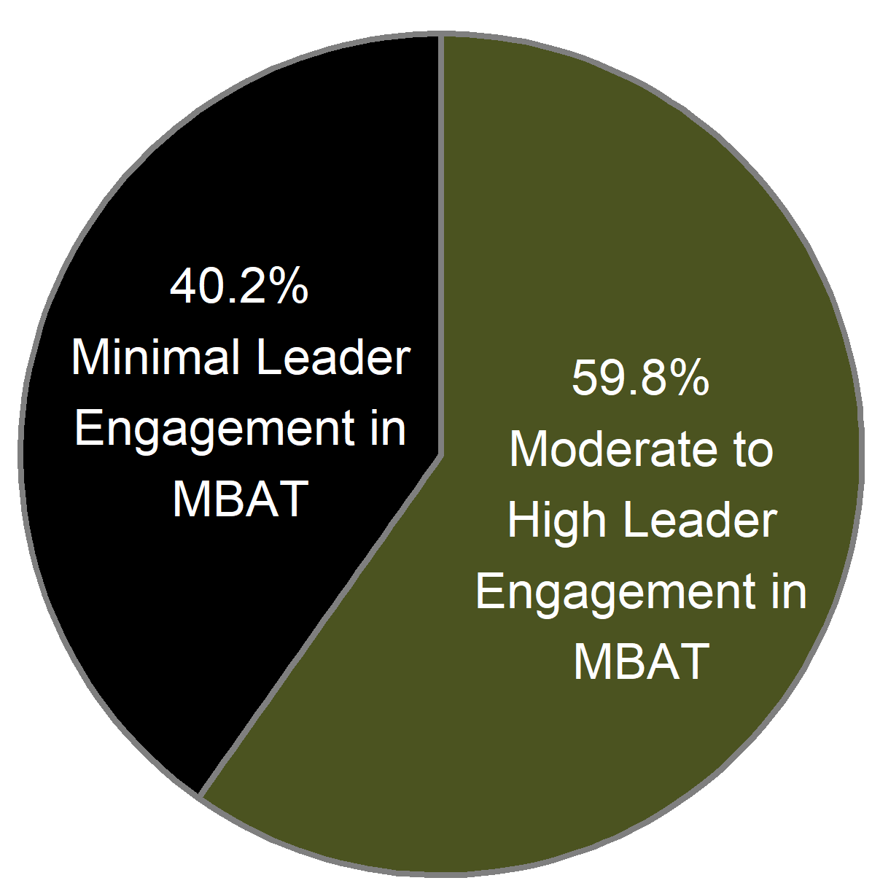
Leader Engagement and Practice
  Note: Leadership level defined by trainees’ reported level of leadership at T4 (Not at all vs. A little bit or more)
  *High practice significantly higher over time relative to low practice at p<.05 on continuous outcome

Slide 19

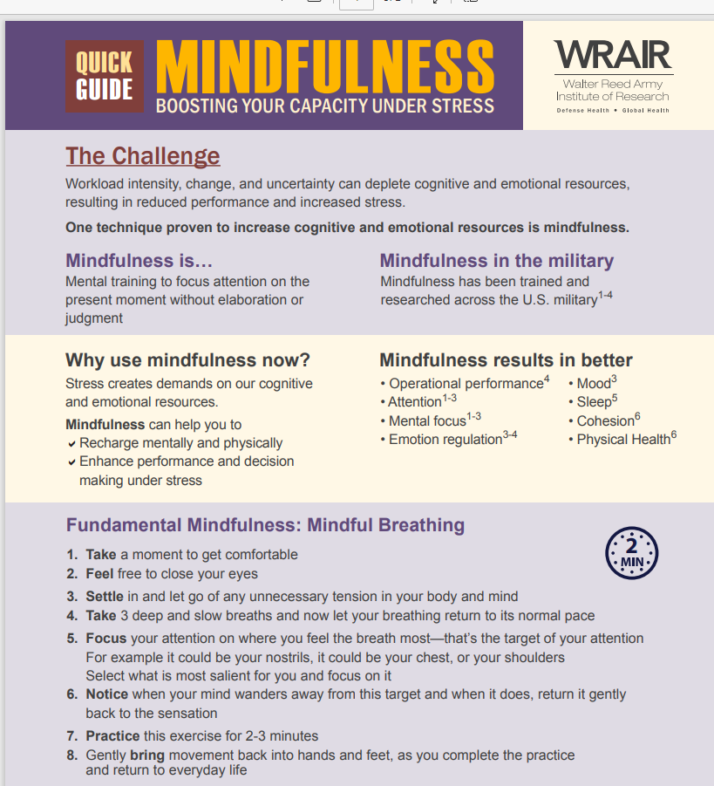
WRAIR Training Products
WRAIR Minds Podcast
  Mindfulness Quick Guide

Slide 20
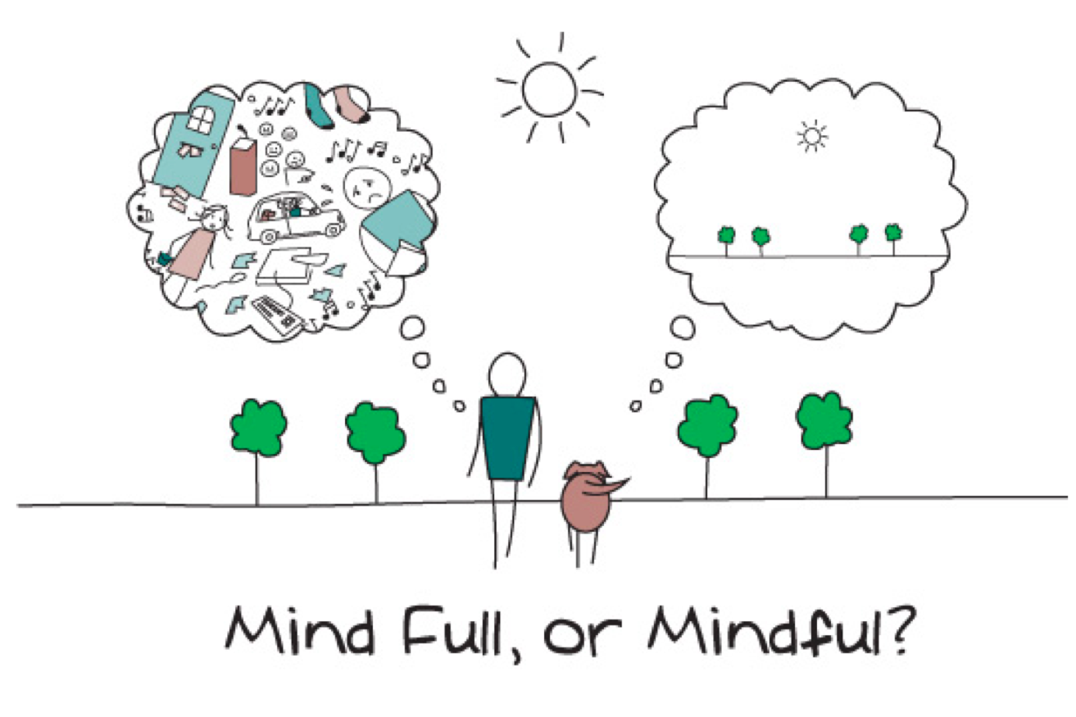

Slide 21


