Slide 1

Hazardous Hitchhikers: Tracking “Superbugs” from Battlefield to Bedside
Patrick Mc Gann, PhD
Multidrug-Resistant Organism Repository and Surveillance Network (MRSN),
Walter Reed Army Institute of Research (WRAIR)
Silver Spring, Maryland, USA

Slide 2
Disclaimer:
Material has been reviewed by the Walter Reed Army Institute of Research. There is no objection to its presentation and/or publication. The opinions or assertions contained herein are the private views of the author, and are not to be construed as official, or as reflecting true views of the Department of the Army or the Department of Defense.

Slide 3

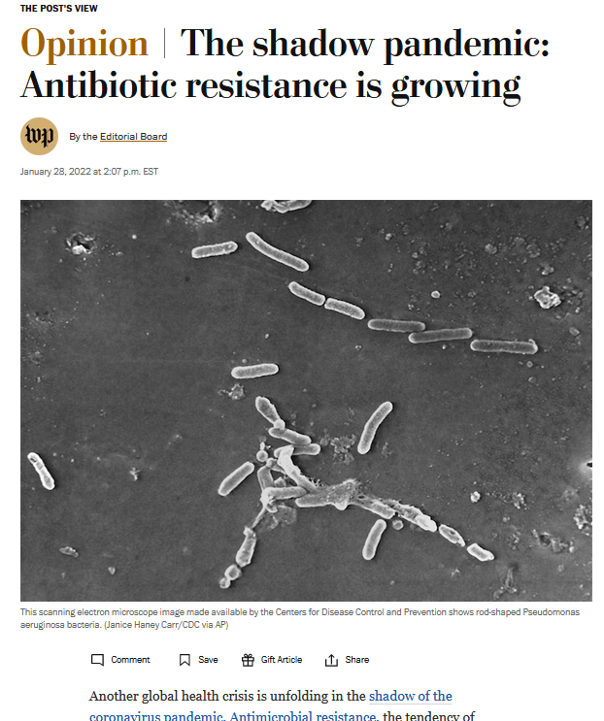
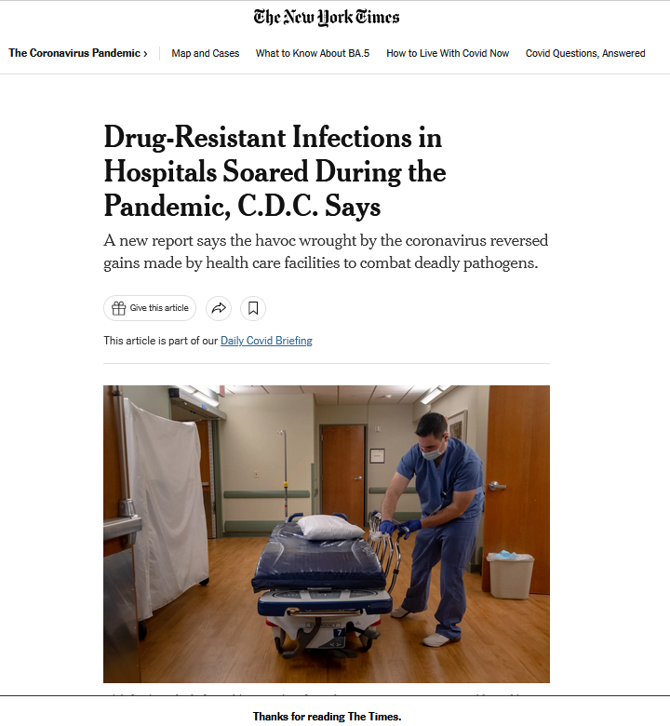


Slide 4
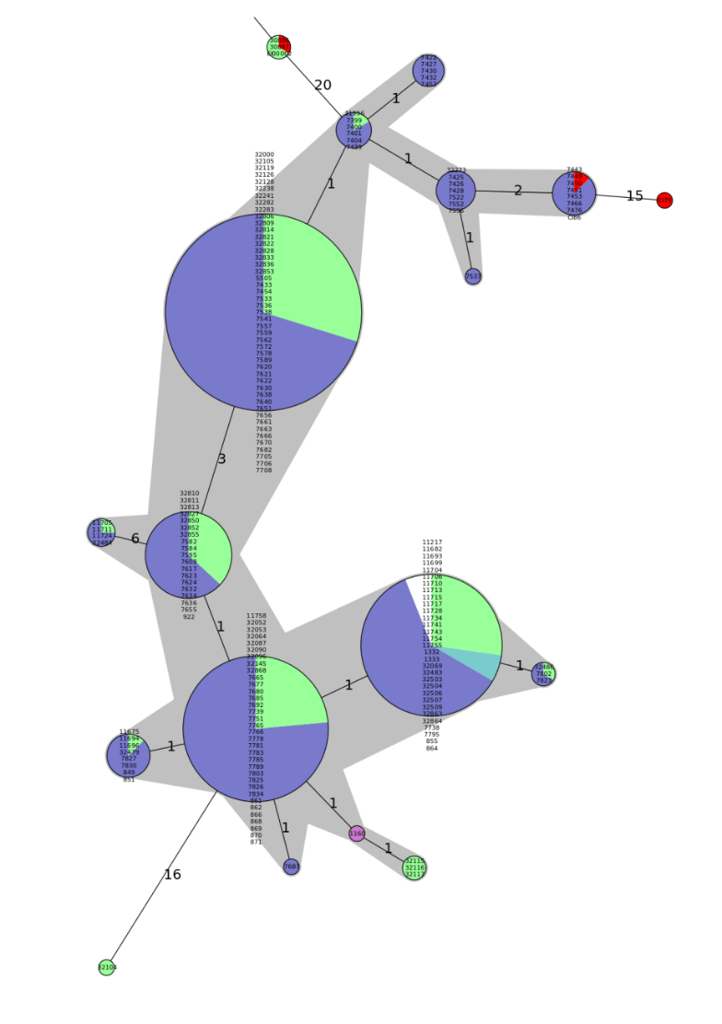
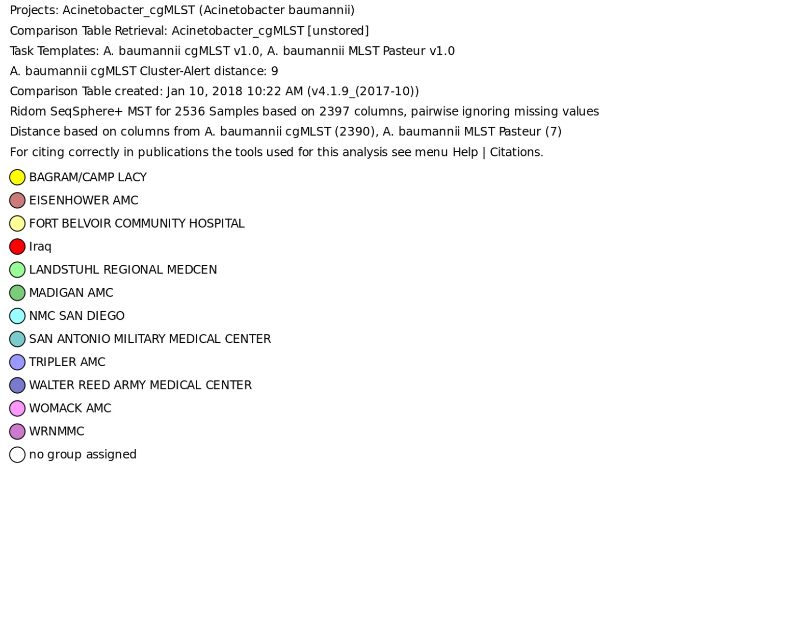
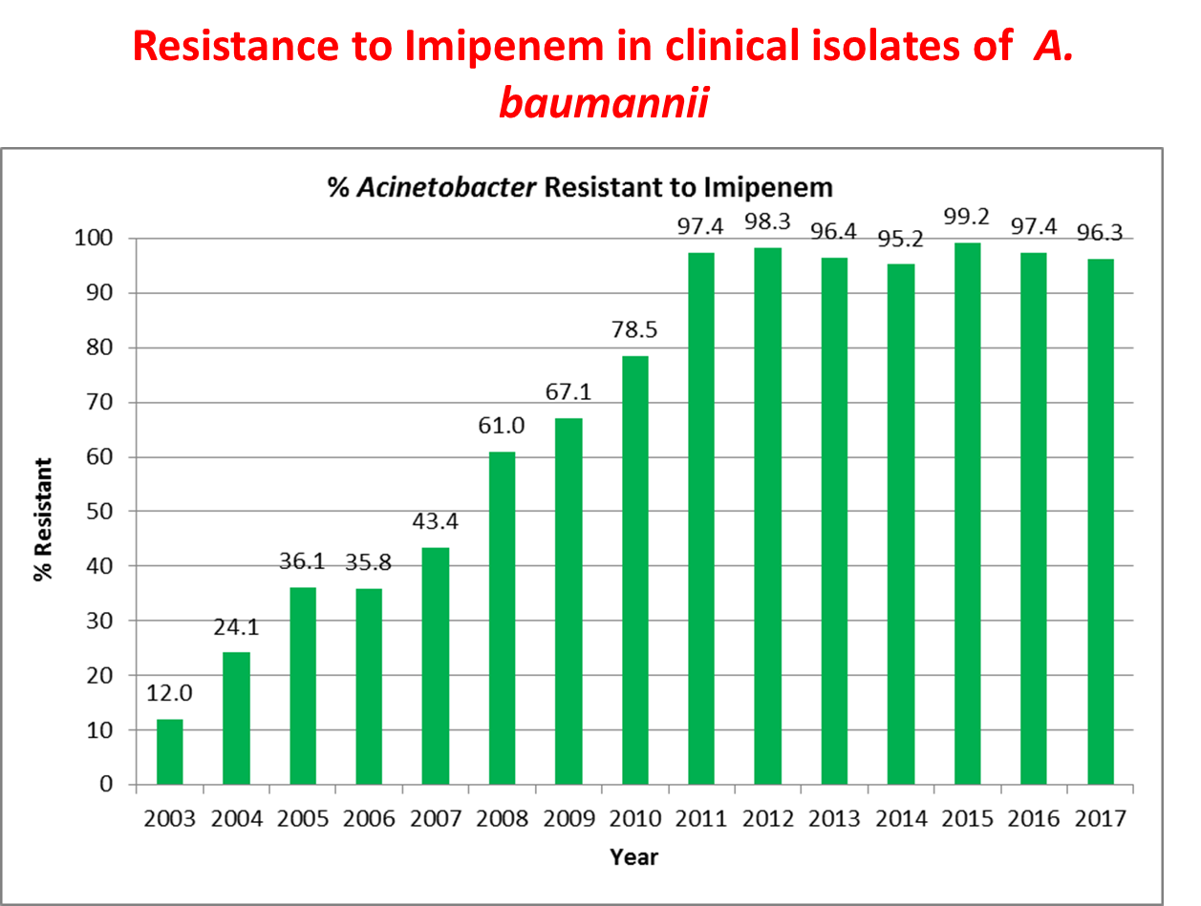
Importance of Surveillance
OIF, OEF and the “Iraqibacter”
2004
Genetic relatedness of A. baumannii, (ST 25) from clinical cultures in the military healthcare system (MHS)
2005
2005-2006
2007-2017
2005-2007
Bianca Seidman, NPR, 2011
Infection control nightmare
1st Acinetobacter baumannii (+) culture of Iraq war: April 11th, 2003 from the sputum of an Iraqi national at Landstuhl, Germany
1st A. baumannii (+) culture from a U.S. service member at Walter Reed AMC (WRAMC) occurred on April 20th, 2003
Within 1 week, 12 more cases were reported at WRAMC
2006-2007
Notes:
ST25

Slide 5
MRSN Primary Missions
Ad hoc outbreak investigations (bacterial and fungal) for the whole Military Healthcare System (MHS)
Routine, real-time genomic surveillance of nosocomial transmission for select facilities (bacteria).
Identification and Tracking of multi-drug resistant (MDR) bacteria globally in collaboration with GEIS.
Maintain repository of clinically relevant isolates/genomes for surveillance and R&D
Provide extended antibiotic susceptibility testing to MTFs

Slide 6
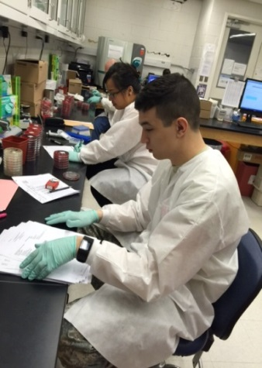

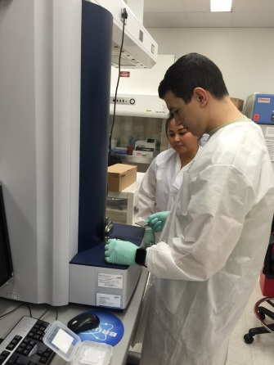
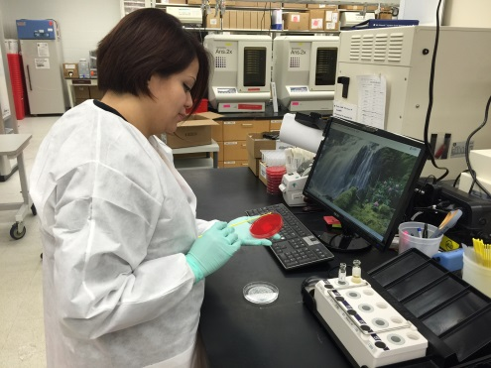
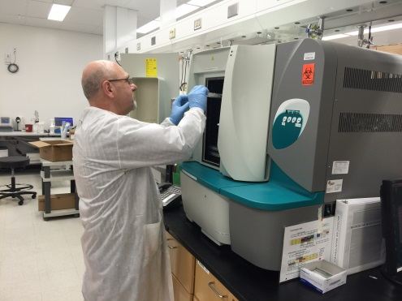
Clinical Microbiology Laboratory
800-1,300 new isolates/month
Initial specimen processing; Data creation and storage
Identification (Mass spectrometry)
Antibiotic susceptibility testing (Sensititre, broth microdilution, E-tests)
With permission of MRSN personnel

Slide 7
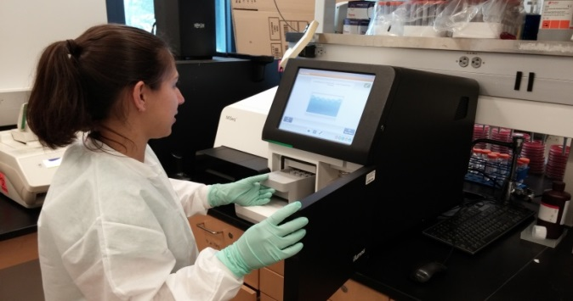
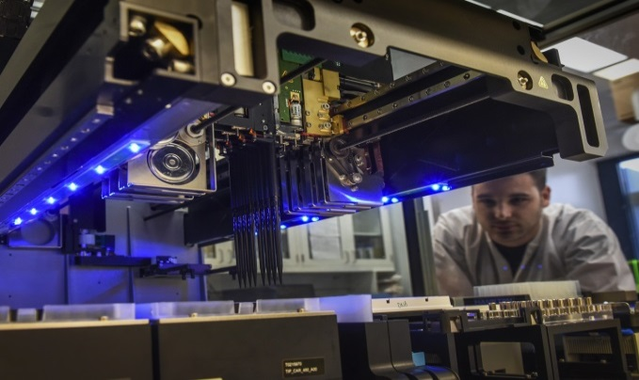
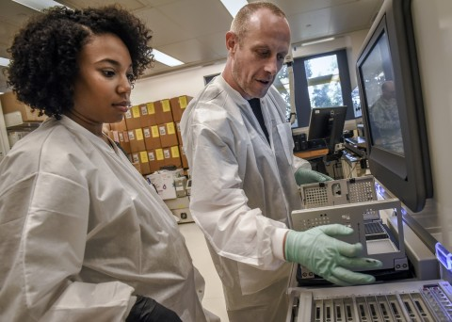
Molecular Microbiology & Sequencing Lab
1,200-1,800 isolates sequenced/month
  MiSeq® (small: 10-30 samples) and NextSeq® (Large: 100+)
  Oxford Nanopore MinION ®
Multiplex PCR assays
  Species-specific primer sets (ESKAPE)
  MRSA (mecA, mup, qac A/B, pvl)
  Carbapenem-resistance (bla_{KPC, IMP,} _{NDM,} _{OXA 48-like,} _{VIM})
  16s methylases AG resistance (armA, npmA, rmtA-H)
  MDR Acinetobacter (bla_{OXA} _{23, 24, 58})
CARBA-5® screening
With permission of MRSN personnel

Slide 8
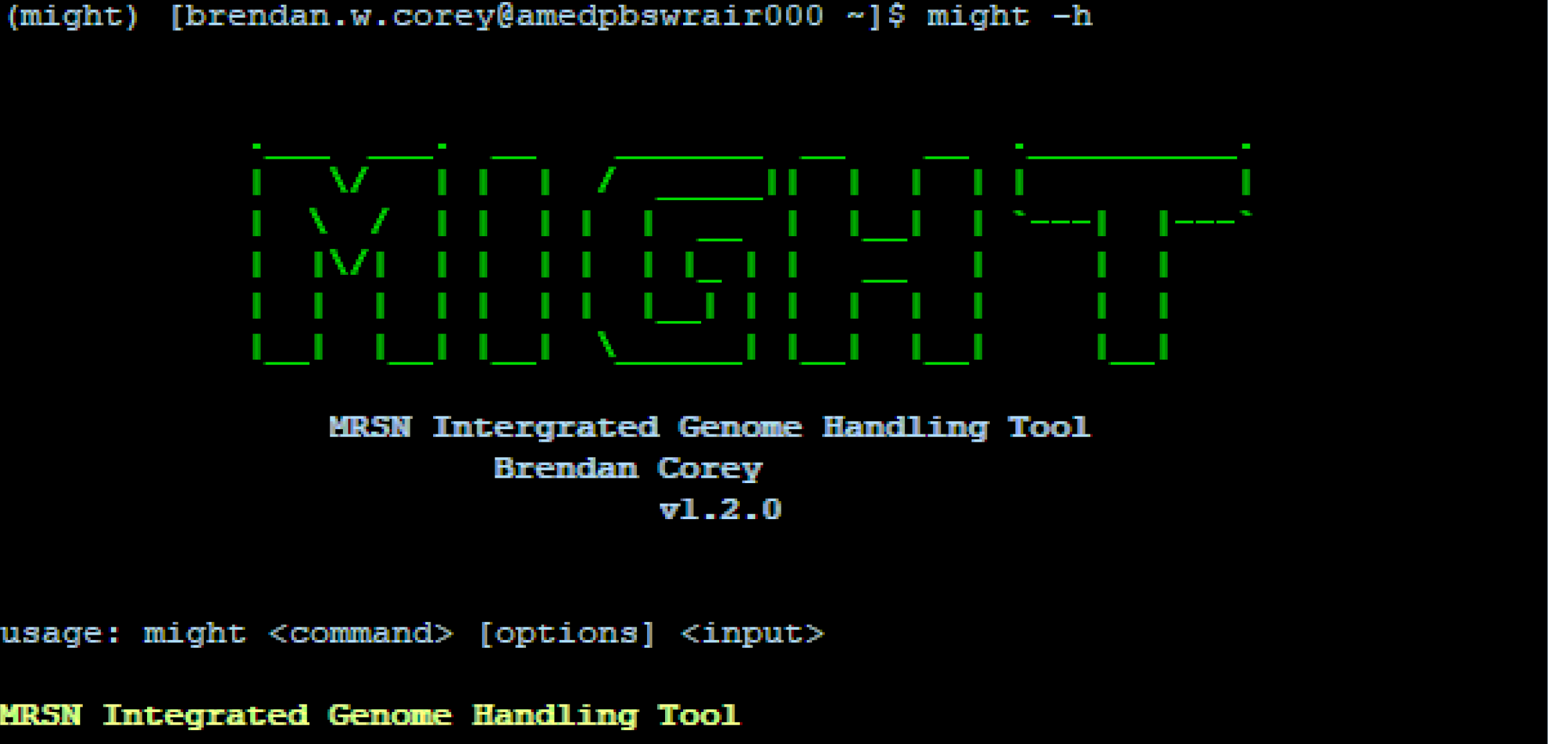
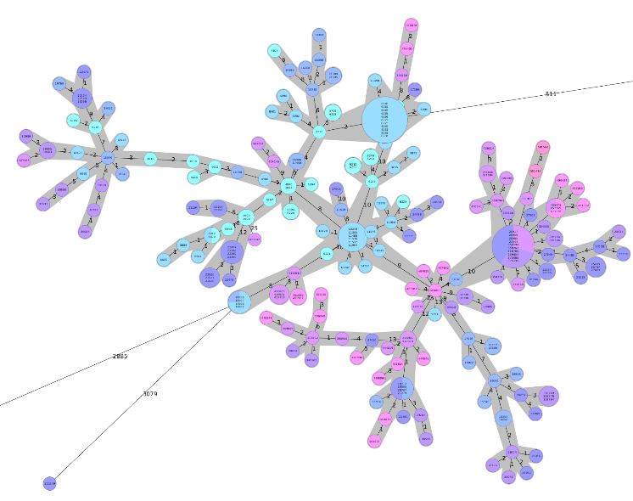
Bioinformatics Group
1,000-1,500 assembled genomes/month
10 full-time bioinformaticists
Analysis of NGS data utilizing custom, semi-automated analysis pipeline
Repository of >60K genomes

Slide 9

ARMoR-Database (ARMoR-D)

Slide 10
Target Organisms
“MDR” ESKAPE+ pathogens
  Enterococcus faecium (vancomycin-resistant)
  Staphylococcus aureus (methicillin-resistant)
  Klebsiella pneumoniae
  Acinetobacter spp
  Pseudomonas aeruginosa
  Enterobacter spp, Escherichia coli
ESBLs, Carbapenem and/or colistin resistant GNR
Clostridium difficile
Other clinically relevant organisms (upon request)
  Problematic identification or outbreak/transmission investigations
  MSSA, H. influenzae, GAS, Neisseria gonorrhoeae
“MDR” definition:
non-susceptible to 1+ drug from 3+ classes
Magiorakos et. al. 2011. Clin Microbiol Infect. 18:268-281

Slide 11
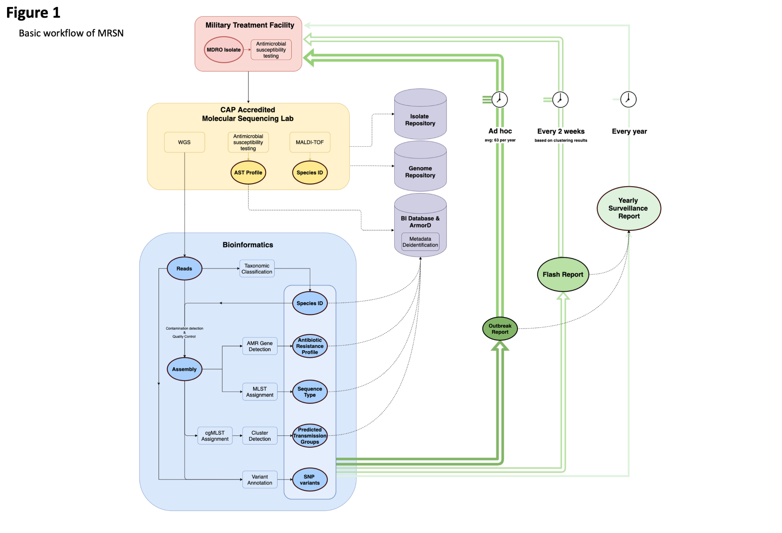
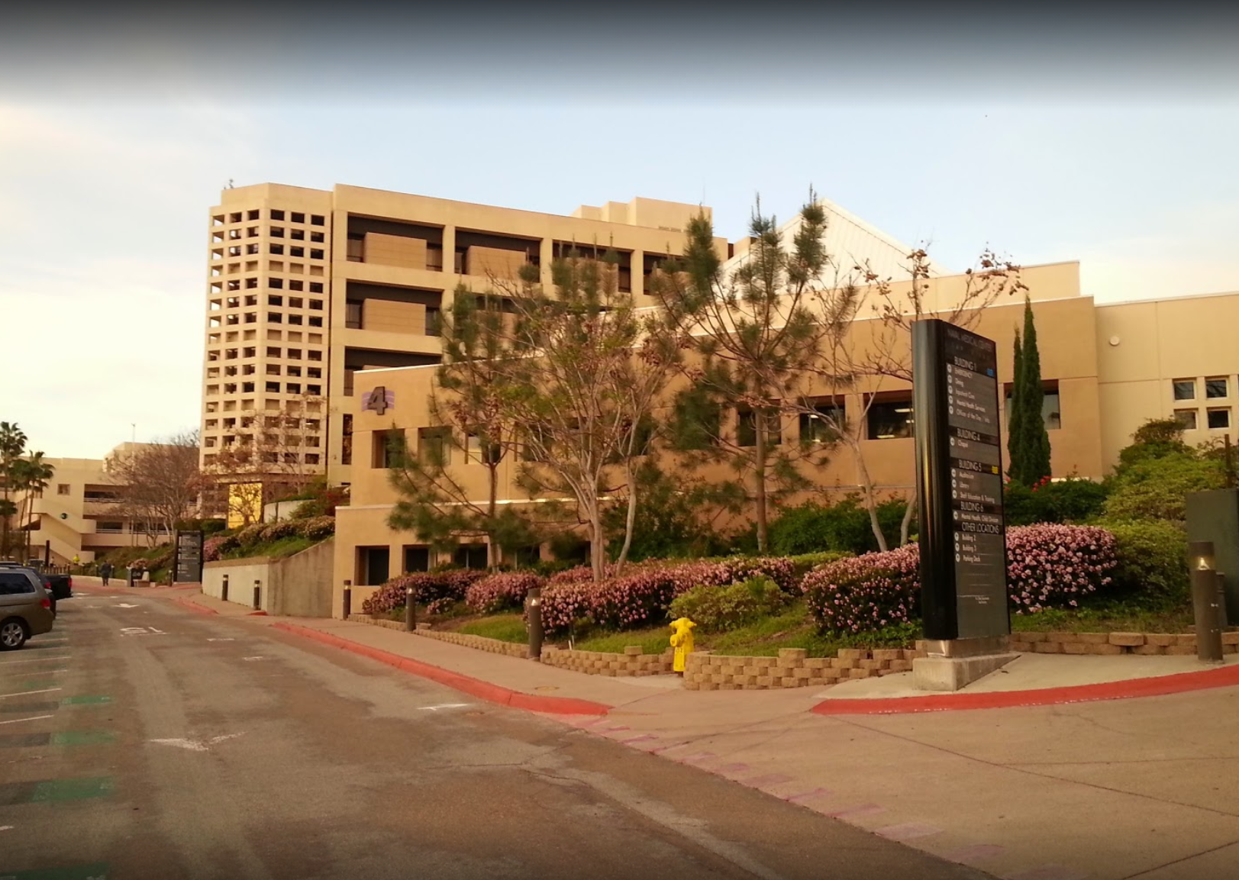
Surveillance and Reporting Pipeline
CAP accredited clinical laboratory
High-throughput sequencing lab

Slide 12
MRSN Primary Missions
2. Routine, real-time genomic surveillance of nosocomial transmission for select facilities.

Slide 13
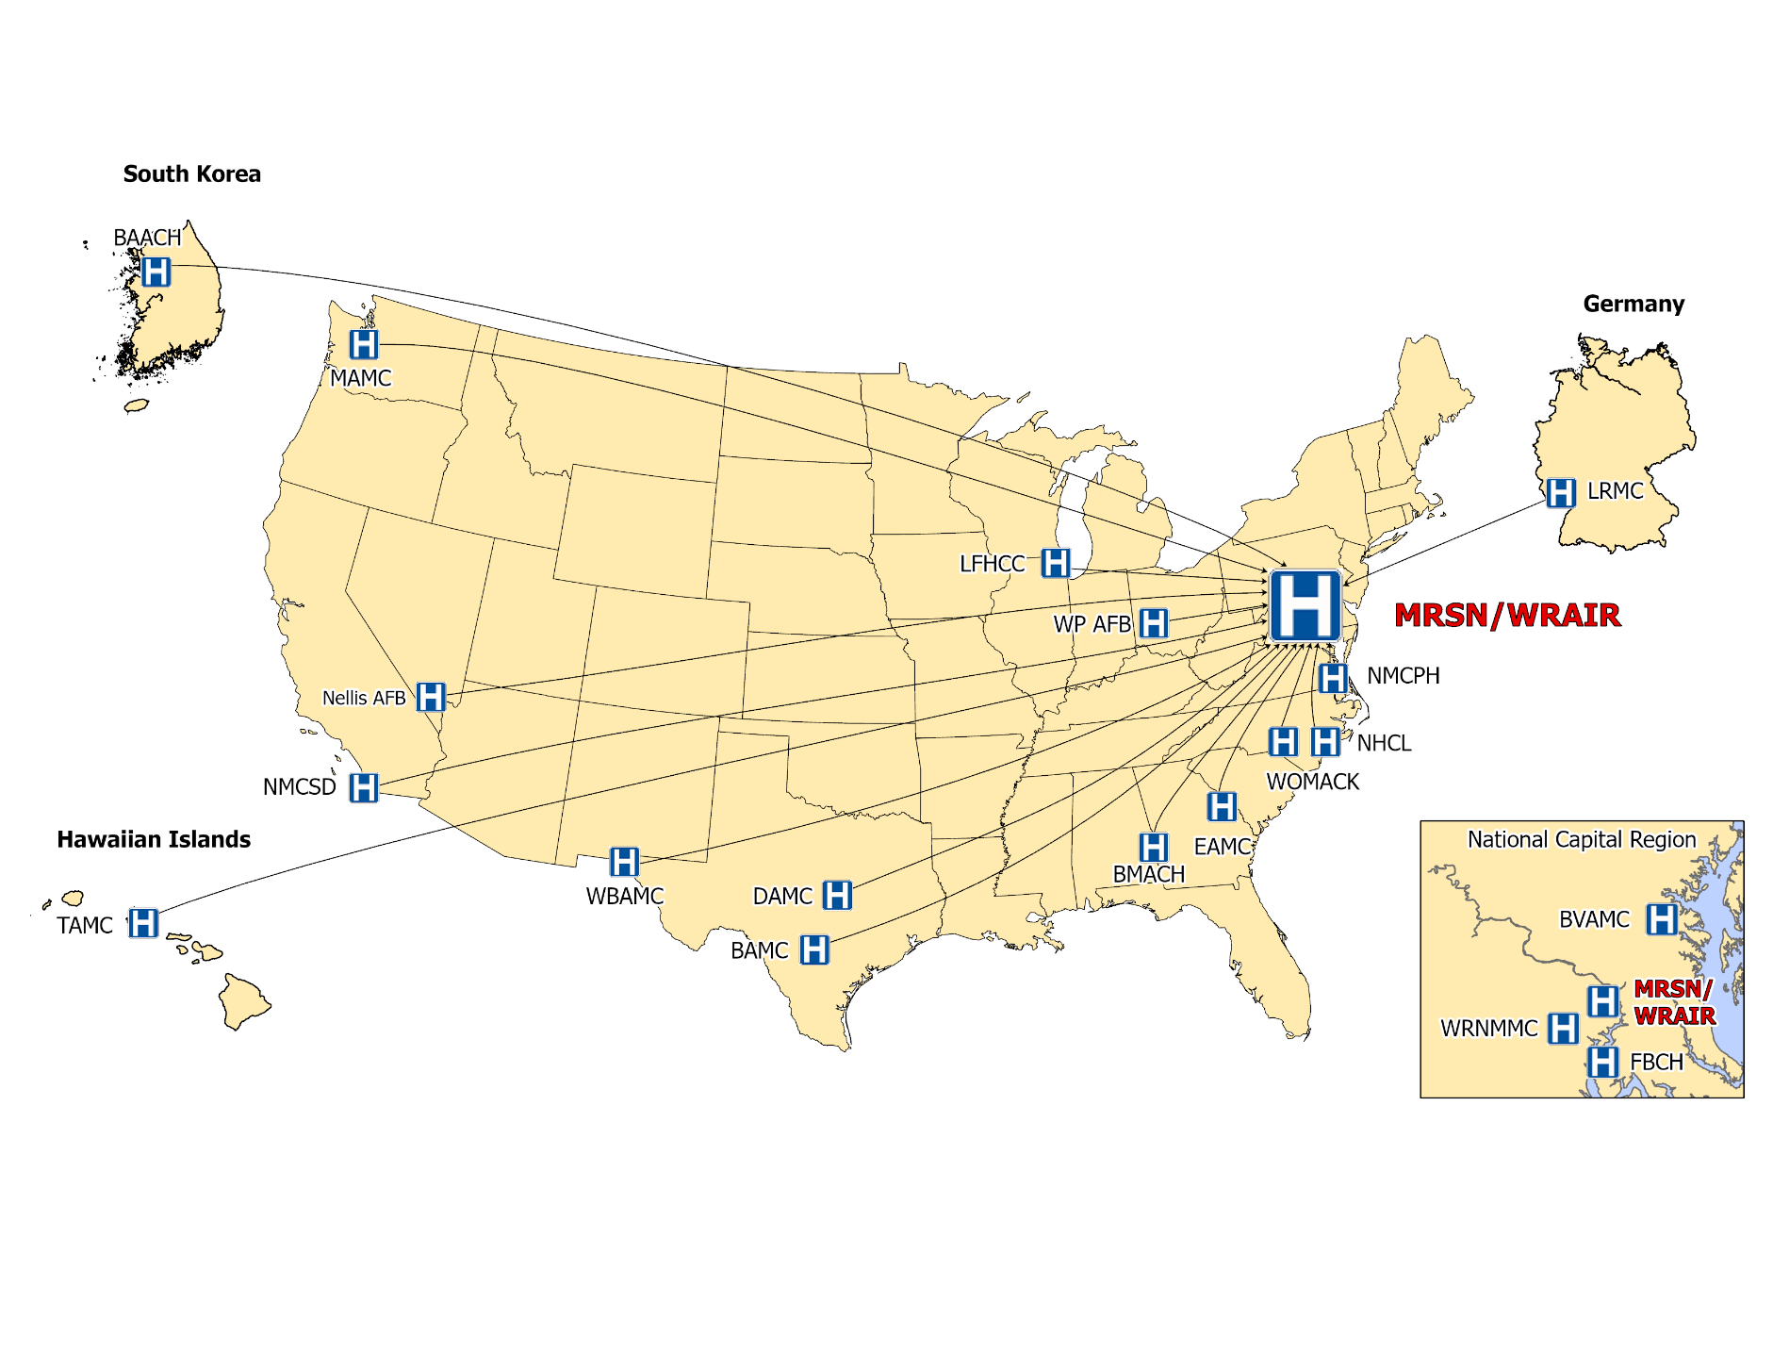
MRSN/GEIS Network (MHS)
MRSN staffing onsite at MTFs (current 15 DoD + 1 VA)

Slide 14
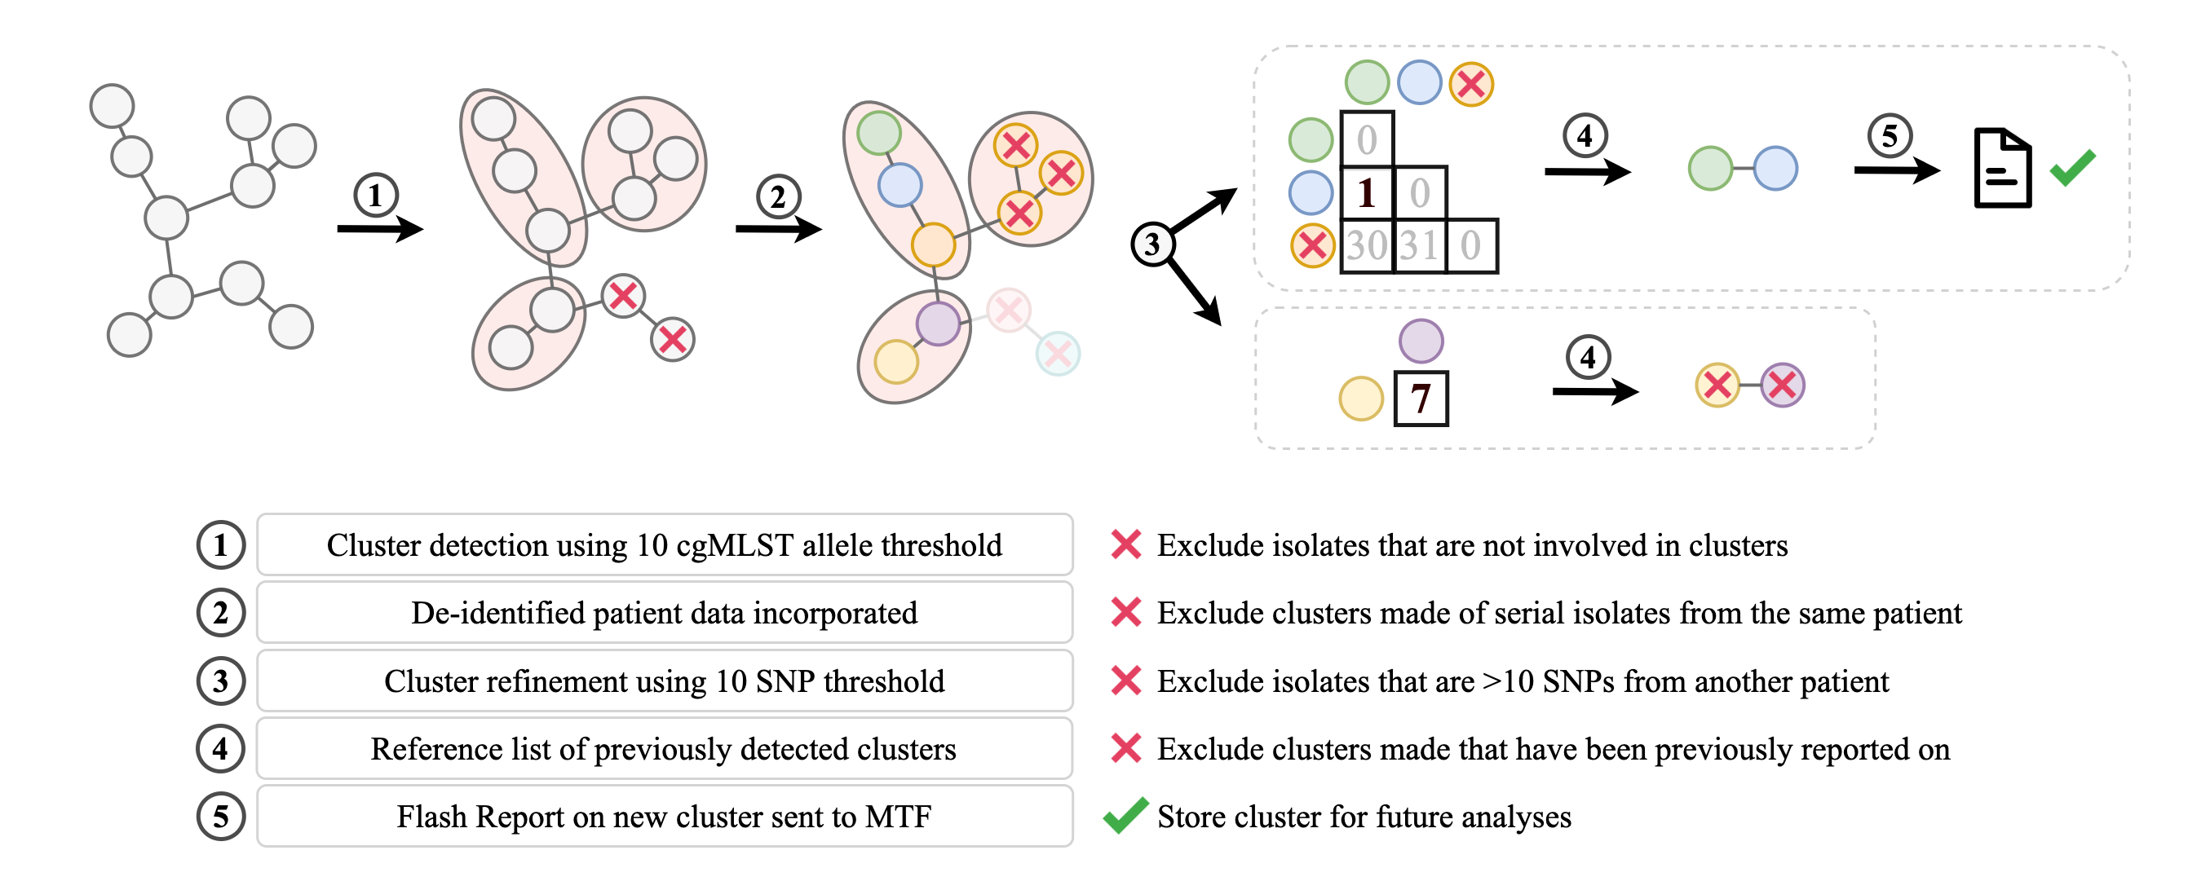
Integrated genome, isolate, and patient data for rapid cluster detection
Flash Report

Slide 15
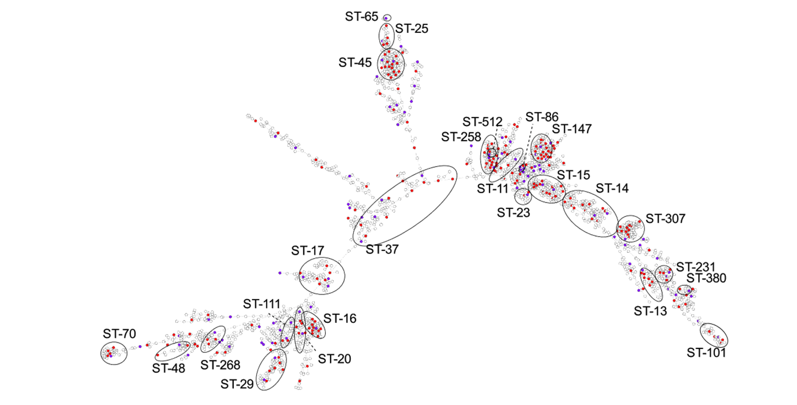
cgMLST minimum spanning tree of 3,123 primary K. pneumoniae isolates.

Slide 16
MRSN Primary Missions
3. Identification and Tracking of
multi-drug resistant (MDR) bacteria globally in collaboration with GEIS.
Figure from Lindsey Hall

Slide 17
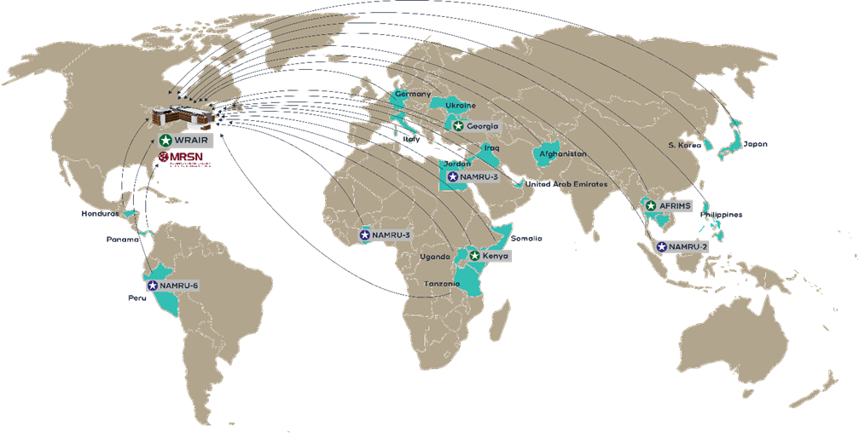
MRSN/GEIS Network (Overseas)

Slide 18
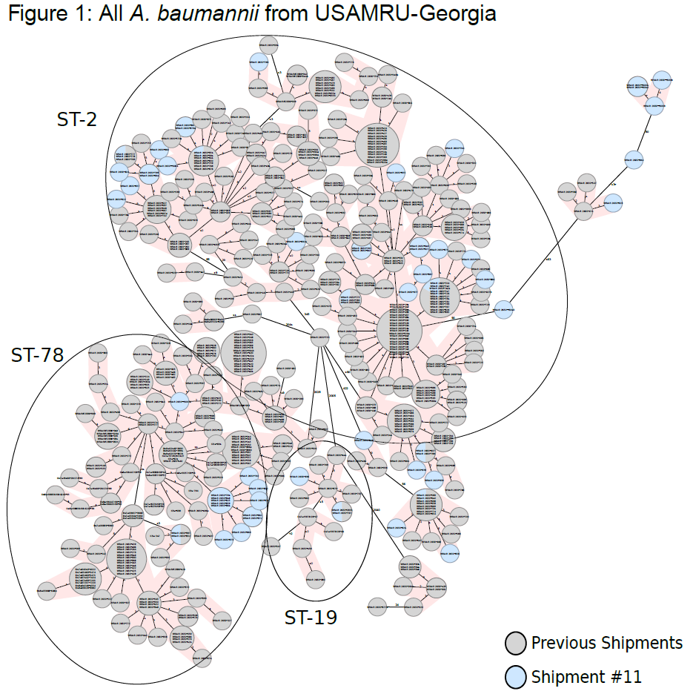
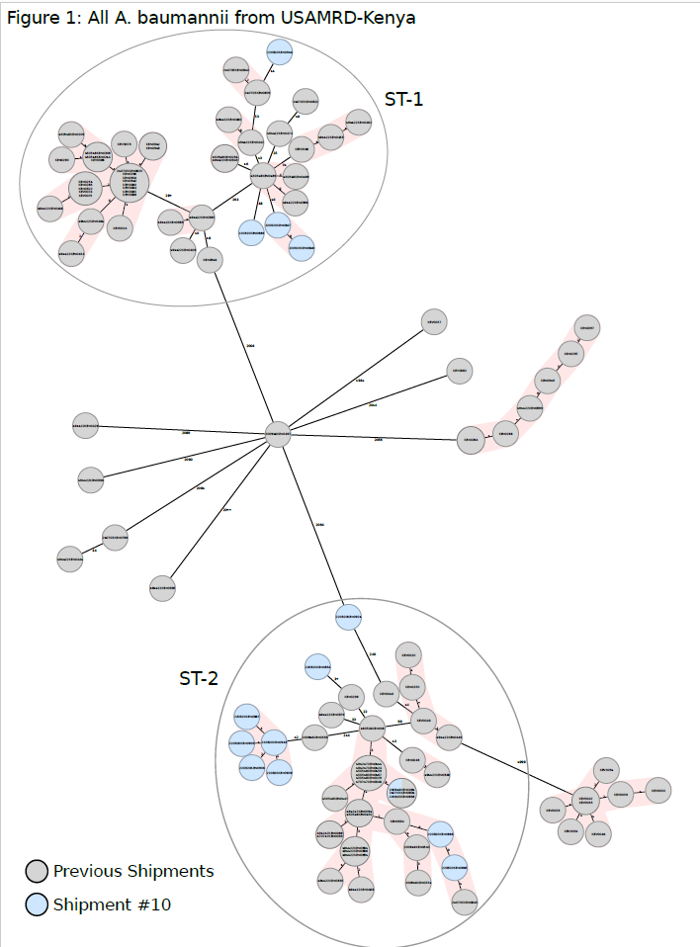

Slide 19


Slide 20
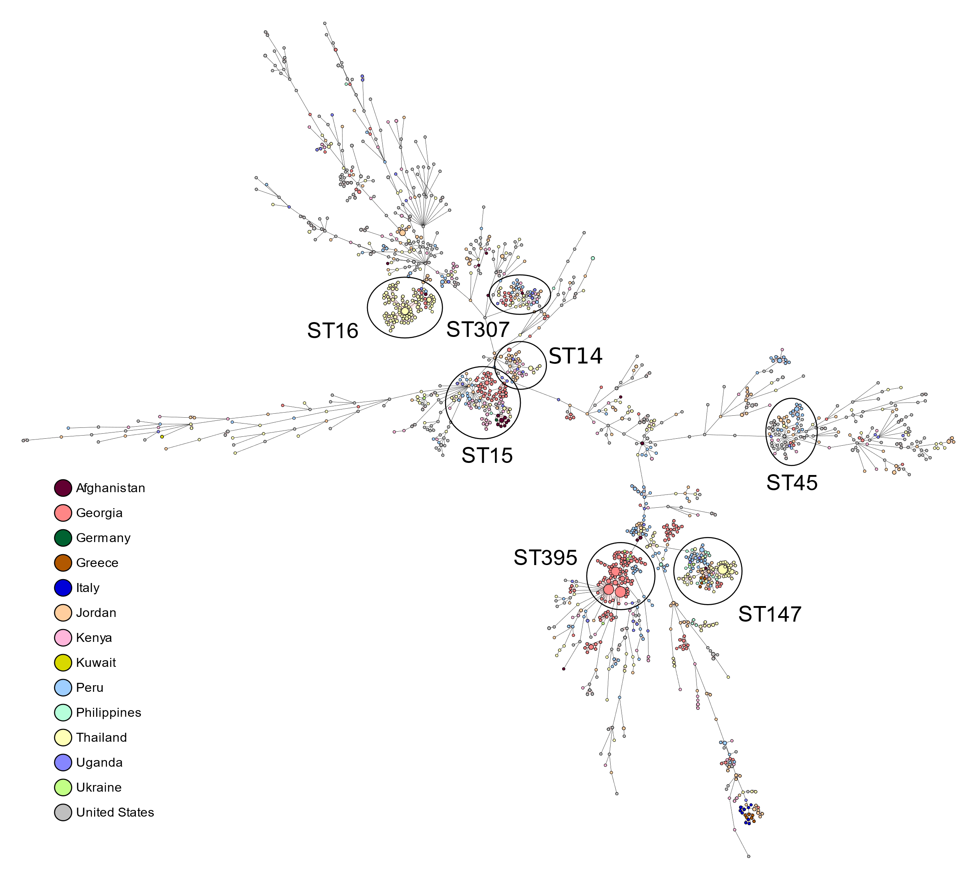

Slide 21
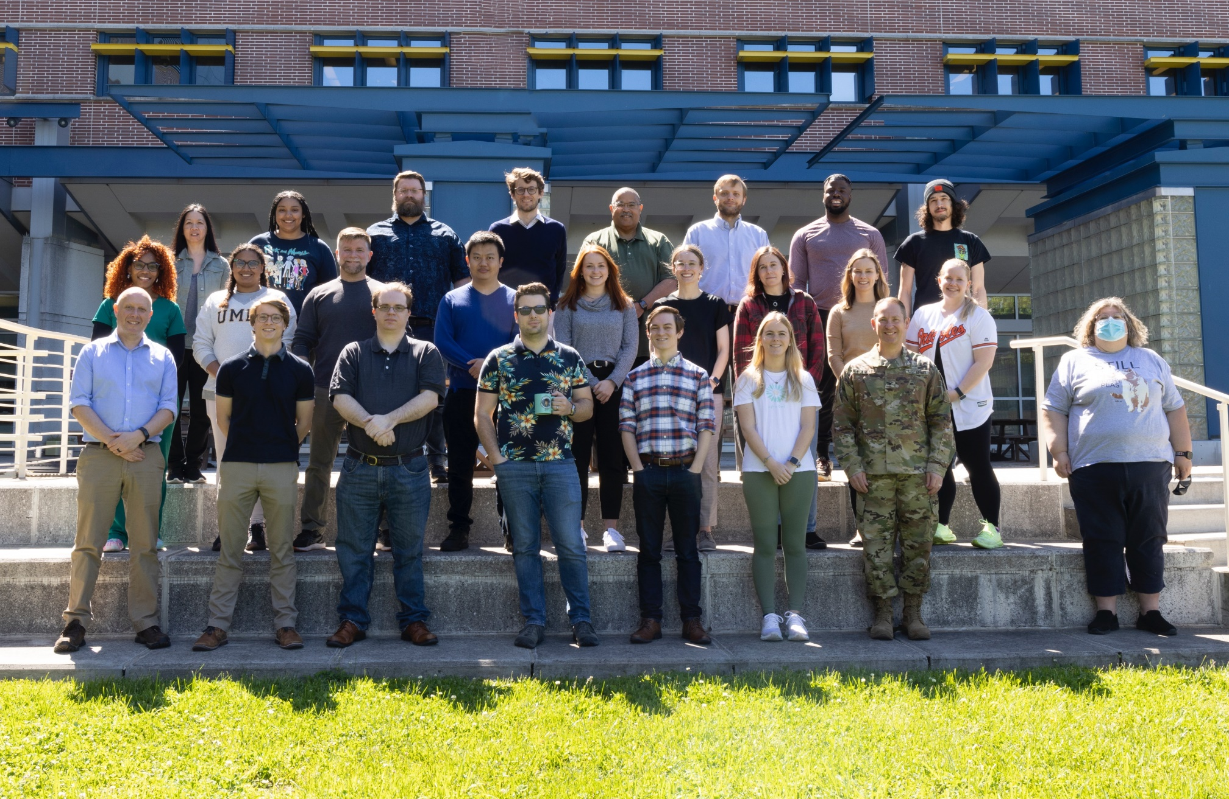



Acknowledgements
Offsite MRSN staff
Mr. Aubrey Powell (BAMC)
Mr. Henry Dao (LRMC)
Ms. Idalia Gonzalez-Seanz (WBAMC)
Mr. Jonathan Amos (NMC San Diego)
Ms. Yahui Nelson (NH Camp Lejeune)
Ms. Jolene Osborn (MAMC)
Mr. Mauro Ostiguin (DAMC)
Ms. Cynthia Myer (EAMC)
Ms. Maria Hoffmann (Martin AMC)
Ms. Heather Deffenbaugh (WOMACK)
Ms. Themia Hoggs (NMC Portsmouth)
Mr. Tatdanai Kitjawat (TAMC)
Mr. Mauro Ostiguin (DAMC)
Ms. Ellye Caplan (Baltimore VA)

Slide 22

patrick.t.mcgann4.civ@mail.mil

