Slide 1




Diversity and Inclusion in Clinical Research
Deidre V. Washington, PhD
Research Integrity Specialist
Research Ethics and Integrity (REI) Team
WRAIR
May 16, 2022

Slide 2
Disclaimer
The opinions contained in this presentation are not intended to represent the position of WRAIR
The speaker has no personal conflict of interest relevant to this presentation
Notes:
Kim- Could make this statement

Slide 3
Overview
The importance of diversity and inclusion in clinical research and historical examples
Barriers to clinical trial participation for historically underrepresented groups
Potential solutions for improving clinical trial diversity, including community engagement
The importance of diversity in the scientific workforce

Slide 4
Overview
The importance of diversity and inclusion in clinical research and historical examples
Barriers to clinical trial participation for historically underrepresented groups
Potential solutions for improving clinical trial diversity, including community engagement
The importance of diversity in the scientific workforce

Slide 5
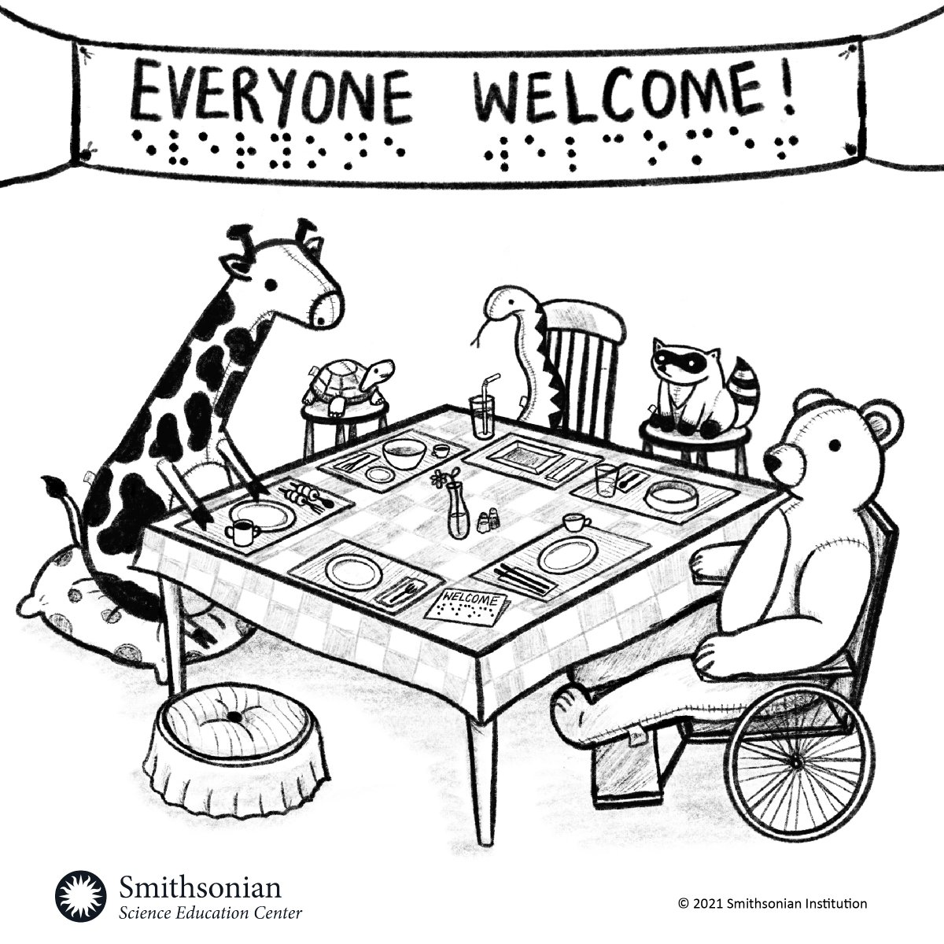
Diversity, Equity and Inclusion
Diversity: The presence of differences within a given setting.
Equity: Ensuring that processes and programs are impartial, fair and provide equal possible outcomes for everyone.
Inclusion: Ensuring that people feel a sense of belonging in the workplace, so that every employee feels comfortable and supported by the organization when it comes to being their authentic selves.
https://builtin.com/diversity-inclusion/what-does-dei-mean-in-the-workplace
Notes:
Diversity: The presence of differences within a given setting, such as differences in race, ethnicity, gender, gender identity, sexual orientation, age and socioeconomic class. Emphasize here that we mean everyone.
Equity: The act of ensuring that processes and programs are impartial, fair and provide equal possible outcomes for every individual.
Inclusion: The practice of ensuring that people feel a sense of belonging in the workplace, so that every employee feels comfortable and supported by the organization when it comes to being their authentic selves.

Slide 6
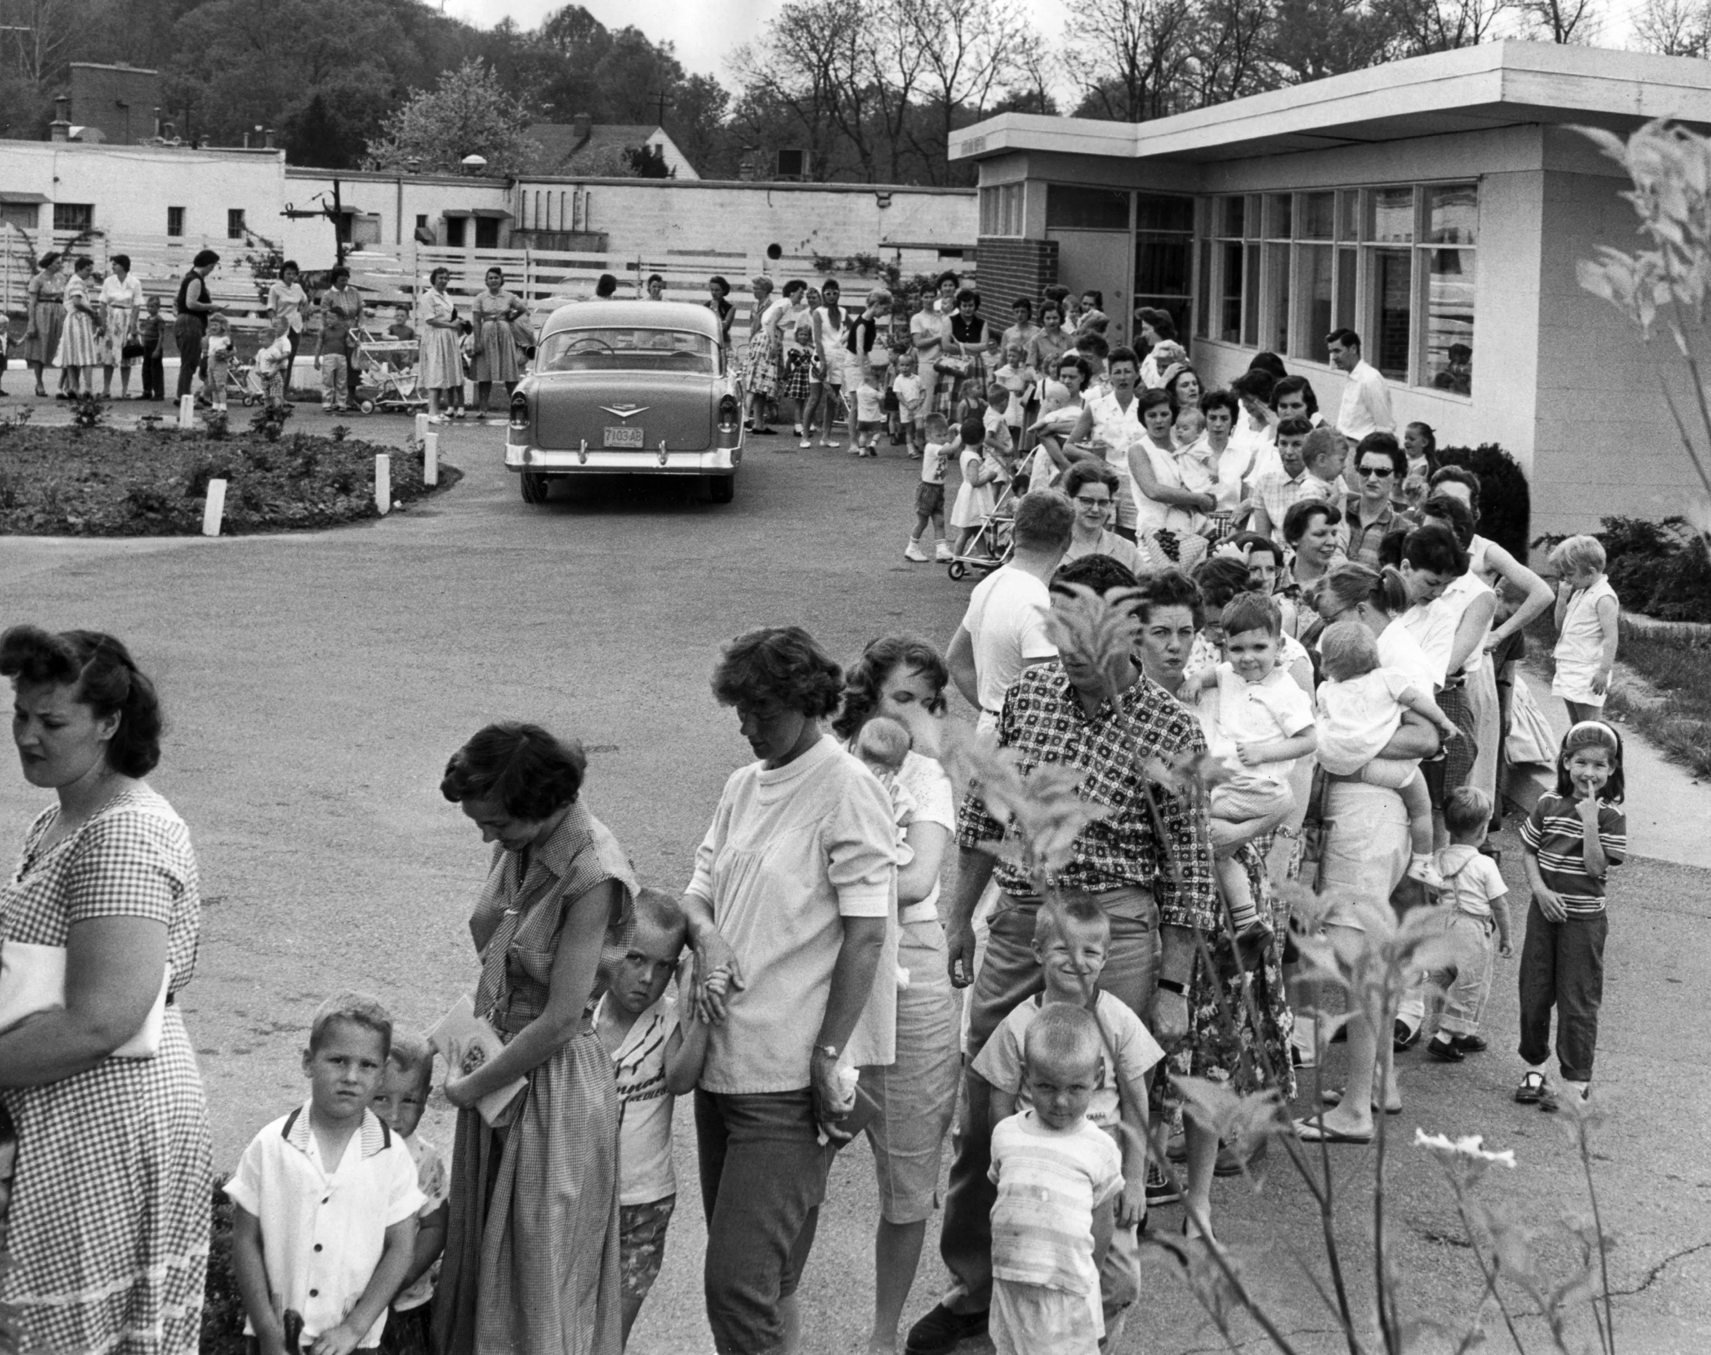
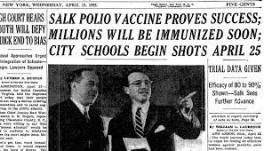
Medical research is critical to protect public health
  Research is needed to test vaccines, treatments, and other health interventions that benefit public health
  Clinical trials are used to test these various medical interventions
  The clinical trial process is long and expensive, but results can have huge impacts
Photo credits:
https://www.cincinnati.com/story/news/2020/12/10/covid-vaccine-sabin-sunday-polio/3863706001/
https://vaxopedia.org/2016/10/12/jonas-salk/
Notes:
Using an example from an earlier era: the polio vaccine eradicated polio in the United States; the vaccine was tested and found to be effective in a huge and historic trial conducted in 1954, that enrolled 1.8 million children across the US. After the trial demonstrated that the vaccine was safe and effective, a national campaign for polio immunization was rolled out.

Slide 7
Great advances in clinical research require well-designed and inclusive clinical trials
Historically, participation in clinical trials has not reflected the diversity of the U.S. population
In prior decades, more research was conducted in men than women
  Women were thought to have more biological variability
  Men were considered “the norm” in biomedical research
Black and brown populations are often under-represented in clinical research, relative to their proportion in the population

Slide 8
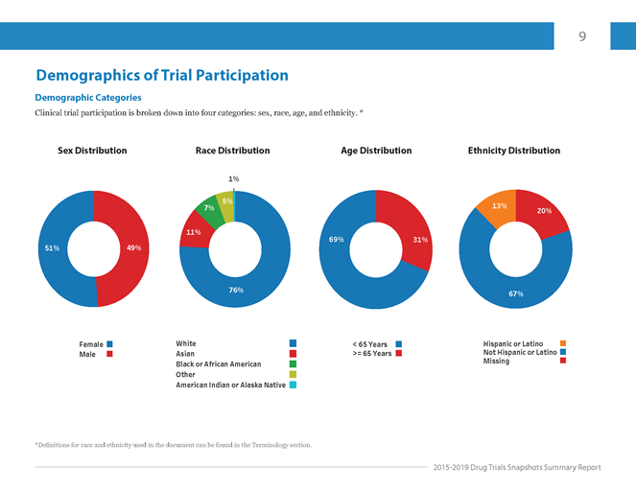
Notes:
https://www.fda.gov/drugs/drug-approvals-and-databases/drug-trials-snapshots
Lack of diversity in clinical trials is an issue that has persisted for a long time.
U.S. Food & Drug Administration’s Center for Drug Evaluation and Research (CDER) published a snapshot of clinical trial demographic data for new drugs to the U.S. market in 2020. The report’s goal was to show differences in the efficacy of certain medications and their side effects among different demographic groups.
CDER’s report for 2015-2019 showed that although participants were evenly split by sex, there was less diversity across other groups like age, race, and ethnicity.

Slide 9
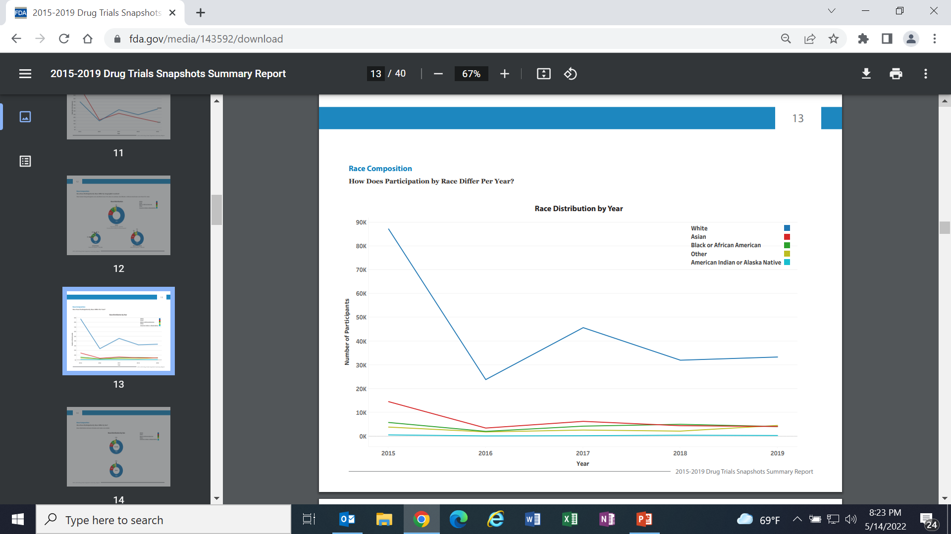
Notes:
https://www.fda.gov/drugs/drug-approvals-and-databases/drug-trials-snapshots

Slide 10
COVID pandemic has posed new challenges for the research community
Need for rapid development of new vaccines and treatments
Need to overcome substantial fear and mistrust among the public about clinical research, challenges of working in pandemic conditions
Some minority groups in the U.S. have been hit especially hard by the COVID pandemic, and these same groups may be reluctant to participate in research

Slide 11
Plavix example
In 2014, the state of Hawaii sued Bristol Myers Squibb and Sanofi over Plavix (clopidogrel) labeling.
Companies failed to disclose that the blood-thinning drug had little effect on 30% of the population and, worse, put some patients at a higher risk for gastrointestinal bleeding.
38% to 79% of Pacific Islanders and 40% to 50% of East Asians were at risk of responding poorly to Plavix because of genetic predispositions affecting their ability to efficiently metabolize the drug; there was not adequate representation of these groups in the clinical trials.
Notes:
Example is from Boden-Albala article (Neuron);

Slide 12

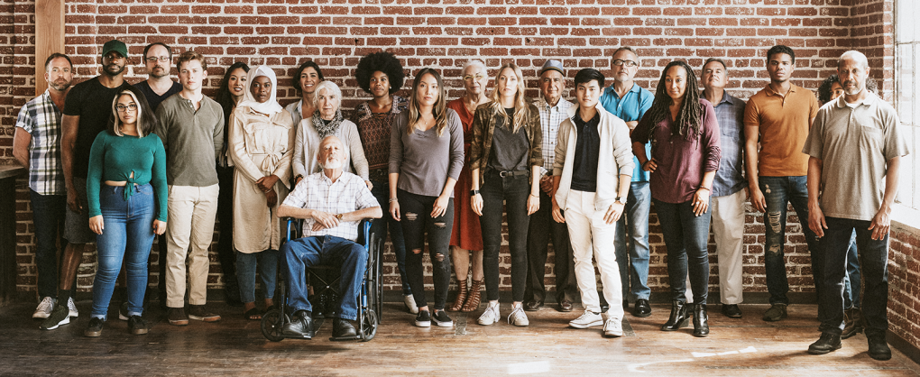
Diverse and equitable representation in clinical research are critical
Lack of diversity could lead to faulty estimates of treatment outcomes, safety and efficacy of vaccines, drugs or other products in different population groups
Diversity and inclusion in research are necessary to ensure that results of medical research are applicable to all groups, including historically underrepresented groups
Photo credits: https://www.fda.gov/consumers/minority-health-and-health-equity/clinical-trial-diversity; https://www.5wpr.com/new/mad-men-public-relations/
Notes:
Discuss the impact representation could have on treatment outcomes, safety, and efficacy
Underrepresented and minority communities may experience different or more co-morbidities due to systemic racism, economic injustice and other factors (usually NOT due to biological differences tied to race); therefore testing interventions in this context is essential to ensure outcomes are consistent across all groups
Inclusion can also facilitate uptake of successful interventions in these populations
E.g. providers, regulators, and patients/the public will have confidence the interventions have been adequately tested in diverse populations;
Medical research may provide direct benefits to study participants; this is especially important for rapidly moving fields where phase 3 trials may be best opportunity to get cutting edge treatments

Slide 13
Discussion
If a family member or close friend came to you for advice on whether to join clinical trial, what would you say?
How would you respond if they mentioned past mistreatment of minorities at the hands of researchers?
What information would you want to know about the current trial to help them make their decision?

Slide 14
Overview
The importance of diversity and inclusion in clinical research
Barriers to clinical trial participation for historically underrepresented groups
Potential solutions for improving clinical trial diversity, including community engagement
The importance of diversity in the scientific workforce

Slide 15
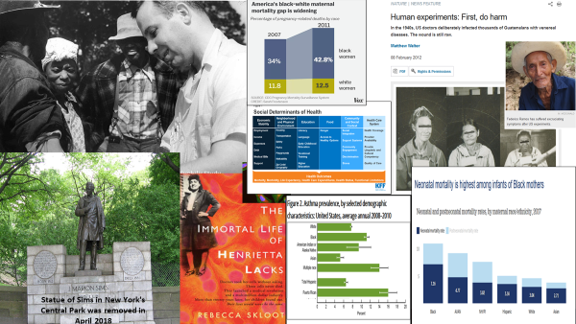
Barriers to clinical trial participation for historically underrepresented groups
Notes:
Most photos from Wikipedia, with CC license.
Cells (Wikipedia): GerryShaw - Immunocytochemistiry using antib
Social determinants of health: https://www.kff.org/racial-equity-and-health-policy/issue-brief/disparities-in-health-and-health-care-five-key-questions-and-answers/
Maternal mortality: https://www.bu.edu/sph/2019/10/11/race-history-and-the-science-of-health-inequities/
Neonatal mortality: https://www.healthsystemtracker.org/chart-collection/infant-mortality-u-s-compare-countries/#item-neonatal-mortality-is-highest-among-infants-of-black-mothers
Asthma rates: https://www.cdc.gov/nchs/products/databriefs/db94.htm
Examples of unethical, racist medical research:
Tuskegee Syphilis Study
J. Marion Sims’s gynecological experimentation on enslaved people
Documented reports of unethical medical research conducted in the 1940s by the U.S. government on unsuspecting people in Guatemala
Recent studies show racial biases persist in health care, showing up in higher rates of death from chronic diseases, unequal access to care and even in assessing and providing treatment for pain.
odies to Actin and Vimentin, using fluorescent sandwich technique Previously published: Not published

Slide 16
Barriers to research participation exist on multiple levels
Research team and research protocol-related factors:
Time constraints of investigators to address engagement and outreach needs, reluctance to increase trial costs to improve diversity
Researcher biases towards specific minority groups
Lack of cultural competency, lack of diverse staff
Study design and research procedures may be burdensome for research participants, e.g. time away from work
Trial eligibility criteria may limit enrollment
Institutional and structural factors:
History of exploitative relationship between research institutions and minority populations
Present-day racism and marginalization, especially with regard to health care
Geographic location (research institutions often in major metro areas only)
Lack of community engagement between the institution and lay communities
Lack of diverse workforce, lack of professional development to support diversity

Slide 17
Individual-level barriers
Experience of ongoing racism and marginalization, including with relation to health care
Mistrust of medical establishment, medical research
Lack of awareness of research
Limited health literacy in some cases
Income level
Logistical issues: transportation, childcare
Language barriers
The need for ID requirements and tax reporting for clinical trial participation
Notes:
“Income is another reason for sparse African-American representation. Clinical trials are largely a middle-class option. A 2015 study found that patients with an annual household income below $50,000 had 32 percent lower odds of participating in a trial than patients with income above that threshold. The median household income of African Americans in 2016 was $39,490, compared to $65,041 for non-Hispanic white Americans.
Patients who can’t afford to travel long distances to a trial, take time off work or find child care are at a disadvantage. They are usually reimbursed for travel and food costs, but drugmakers are careful not to pay too much because they do not want to appear to be enticing patients to join when it isn’t in their medical interests, said Laurie Halloran, founder and CEO of a consulting firm for the drug industry.”
Source: copied verbatim from https://www.propublica.org/article/black-patients-miss-out-on-promising-cancer-drugs

Slide 18
Discussion
Which of these barriers (if any) would be most likely to prevent you (or others you know) from enrolling in a clinical trial?

Slide 19
Recap
Diversity and inclusion are critical to realize the full benefits of research in a just manner, so that all populations and communities can achieve better health outcomes
Marginalized groups are underrepresented in research because they lack access to research, information about research, and trust in researchers and research institutions, among many other factors
A concerted effort is needed by research institutions, regulators, and community-based organizations to work together to address this challenge

Slide 20
Overview
The importance of diversity and inclusion in clinical research
Barriers to clinical trial participation for historically underrepresented groups
Potential solutions for improving clinical trial diversity, including community engagement
The importance of diversity in the scientific workforce

Slide 21
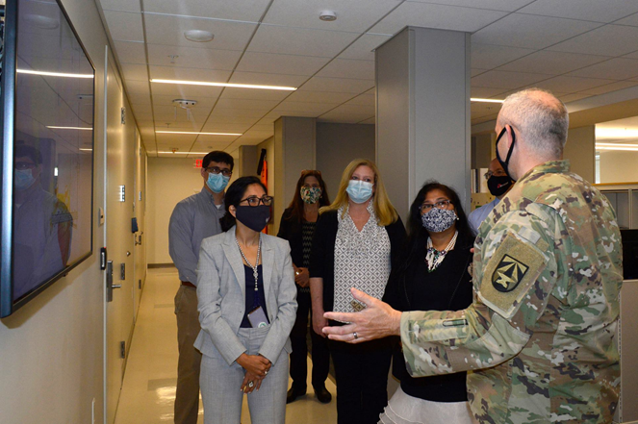
Community and stakeholder engagement can help break down barriers
Community/stakeholder engagement brings communities into dialogue with researchers and research institutions
Community engagement involves working with community-based organizations and representatives to elicit their views and to understand community perspectives and values
Notes:
In the photo, WRAIR clinical trial physicians talk to members of WRAIR’s Community Advisory Board and Community Engagement Team about our COVID-19 vaccine clinical trial

Slide 22
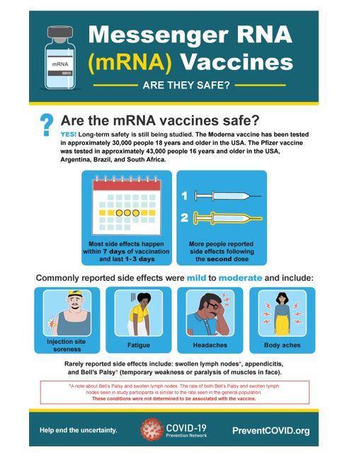
Community engagement can provide vital information about research and help build trust.
Researchers also bring information about the research and address questions, misperceptions, and concerns
Community perspectives can be incorporated into research design, procedures, recruitment, and advertising
Image: Infographic produced by COVPN https://www.coronaviruspreventionnetwork.org/

Slide 23
Critical role of community engagement
Community engagement can helps address current health needs and preparedness (e.g. for future pandemics)
Having robust community engagement structures in place makes research more nimble, responsive, and inclusive
CE processes take time to build and depend on solid relationships
Continuous engagement is necessary to maintain relationships and trust

Slide 24
Diversity in clinical trials: an opportunity and imperative for community engagement
Recommendations include:
  Education on clinical trials that acknowledge historical trauma from unethical trial practices in the USA.
  Engaging grassroots and faith-based organizations.
  Formal training for clinical trial staff on cultural humility, implicit bias mitigation, and recruitment strategies.
Gray II et al, 2021
Notes:
Gray II et al, 2021.
Community members, scientists, clinicians, governmental officials, and biopharmaceutical industry leaders worked together to identify foci for potential solutions.

Slide 25
Diversity in clinical trials: an opportunity and imperative for community engagement
Recommendations include:
  Developing culturally sensitive educational materials such as images and statements from under-represented minorities, and leveraging multimedia platforms to disseminate these materials.
  Resources that both minimize financial costs for participants and that connect academia–community–government–industry partners in sharing best practices to improve diversity in clinical trials.
  Improve the diversity of the staff, scientists, and health-care providers doing clinical trials.
Notes:
Gray II et al, 2021.
Community members, scientists, clinicians, governmental officials, and biopharmaceutical industry leaders worked together to identify foci for potential solutions.

Slide 26
Confronting legacies of underrepresentation in clinical trials
Three key clinical trial research areas to be strengthened to optimize inclusion
  Expansion of the screening pool of eligible participants
  Conversion of eligible to enrolled
  Retention of participants for maximum follow-up.
  “In each of these areas, structural bias at the institutional and investigator level may contribute to health disparities, and we must address these biases to make significant progress toward improving diversity in research trial settings”
Boden-Albala, 2022
Notes:
Boden-Albala, 2022

Slide 27
Expansion of Screening
Q: Is everyone who potentially meets the eligibility criteria in the screening pool?
  Trial participation, and all it entails, should be introduced into community conversations
  Engaging education provided to communities
  Work with community-based organizations and utilize friendly spaces (e.g., town halls)
  Build relationships with local media and leverage community networks
  Sites/Pis should have recruitment/retention plans that target specific populations
  Engagement plans should be developed with communities

Slide 28
Conversion of ‘Eligible’ to ‘Enrolled’
“We must understand the mindset of potential participants about their relationship with research and to the health care system.”
  Understanding individual concerns
  Addressing individual fears
  Clarifying misinterpretations about trial participation in a way that is empathetic
Take time for personal reflection
  Personal biases
  Are there things that you (i.e., the researcher) could have done better?

Slide 29
Retention
Understand the ongoing challenges that participants face:
  Time burden
  Available transportation
  Work conflicts
  Other concerns that involve not just the participant but often their families as well
Consider system-wide changes, including accommodations, so that the burden is shifted:
  Set study hours that accommodate participants’ work schedules
  Provide childcare options
  Budget for transportation
  Arrange for follow-up within communities rather than institution

Slide 30
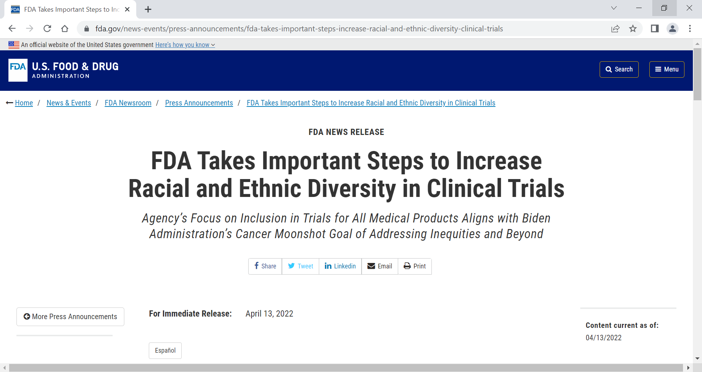
Notes:
https://www.fda.gov/news-events/press-announcements/fda-takes-important-steps-increase-racial-and-ethnic-diversity-clinical-trials

Slide 31
Discussion
Which (if any) of these solutions most personally resonates with you?
Do you think anything is missing?

Slide 32
Overview
The importance of diversity and inclusion in clinical research
Barriers to clinical trial participation for historically underrepresented groups
Potential solutions for improving clinical trial diversity, including community engagement
The importance of diversity in the scientific workforce

Slide 33
Why is DEI Important in the (Scientific) Workplace?
Lack of DEI is bad for science
  Scientists with different perspectives often ask different questions, leading to new insights and discussions
  Teams composed of persons with diverse experiences and areas of expertise tend to be more creative and innovative, with complementary skill sets
  Diverse groups:
    Publish more frequently and are cited more*
    Are better equipped to address health disparities*
    Tend to have better financial returns compared to others in industry**
*Swartz et al, 2019
**Hunt et al, 2015
Notes:
SPS = Society of Physics Students
Adapted from https://www.spsnational.org/the-sps-observer/fall/2014/why-diversity-important-science
Talia H Swartz, et al, The Science and Value of Diversity: Closing the Gaps in Our Understanding of Inclusion and Diversity, The Journal of Infectious Diseases, Volume 220, Issue Supplement_2, 15 September 2019, Pages S33–S41, https://doi.org/10.1093/infdis/jiz174
Also,
More attractive workplace
Attract next generation of employees
67% of millennial and Gen Z employees value diversity when considering employment opportunities*

Slide 34
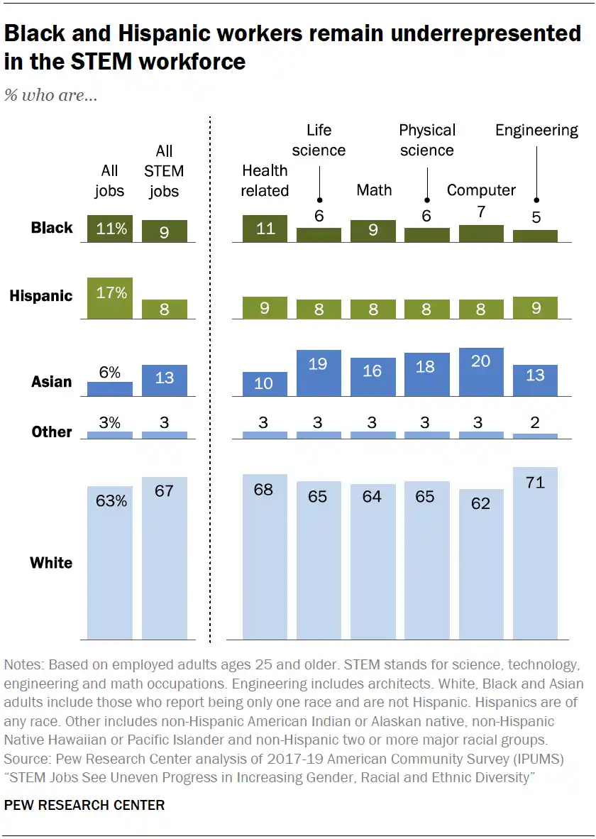
Notes:
Add source to slide
Black people accounted for 9% of the STEM workforce in 2019. That’s the same proportion as in 2016, suggesting a lack of progress at a time when many companies and universities had pledged to promote diversity. Over the same period, the proportion of Hispanic workers in STEM jobs rose from 7% to 8%. Black and Hispanic people make up 12% and 17% of the US workforce, respectively.
Black employees accounted for 6% of all jobs in the life sciences in 2019, up from 4% in 2016. In that same period, the proportion of Hispanic employees in the life sciences increased from 7% to 8%. They also accounted for 8% of all jobs in the mathematics field in 2019, up from 6% in 2016. Over that period, the percentage of Black people in maths-related jobs held steady at 9%.
Asian people, who made up 6% of the working population in the United States in 2019, held 19% of positions in life sciences and 18% of positions in physical sciences. Asian people accounted for 13% of the STEM workforce overall, the same proportion as in 2016.
The report also found that the percentage of women in STEM fields has remained stable. In 2019, women accounted for 47% of the overall workforce and 50% of the STEM workforce.
https://www.nature.com/articles/d41586-021-01089-6#:~:text=Over%20that%20period%2C%20the%20percentage,of%20positions%20in%20physical%20sciences.

Slide 35
2018 PEW STEM Study
Among STEM workers:
Black workers most likely to view workplace diversity as important (84% Black, 64% Asian, 59% Hispanic, 49% White)
The most common reasons believed to contribute to low numbers of Black/Hispanic workers in the field are
  Less likely to have access to quality education to prepare them
  Not encouraged to pursue these subjects from an early age
Black workers are much more likely to say they have experienced discrimination at work due to their race (62% Black, 44% Asian, 42% Hispanic, 13% White)
https://www.pewresearch.org/social-trends/2018/01/09/blacks-in-stem-jobs-are-especially-concerned-about-diversity-and-discrimination-in-the-workplace/

Slide 36
2018 PEW STEM Study
“People have preconceived ideas of what I am capable of doing” Black man
“As a white male, nothing is a given now, you have to fight harder to overcome institutional and government reverse discrimination.” White man
“Hispanics are looked down upon as stupid” Hispanic woman
“The workplace is still geared to the promotion of whites over minorities regardless of the laws in place to promote equality in the workforce.” Hispanic man
“My skills are secondary to my race. My race is seen first” Black woman
https://www.pewresearch.org/social-trends/2018/01/09/blacks-in-stem-jobs-are-especially-concerned-about-diversity-and-discrimination-in-the-workplace/

Slide 37
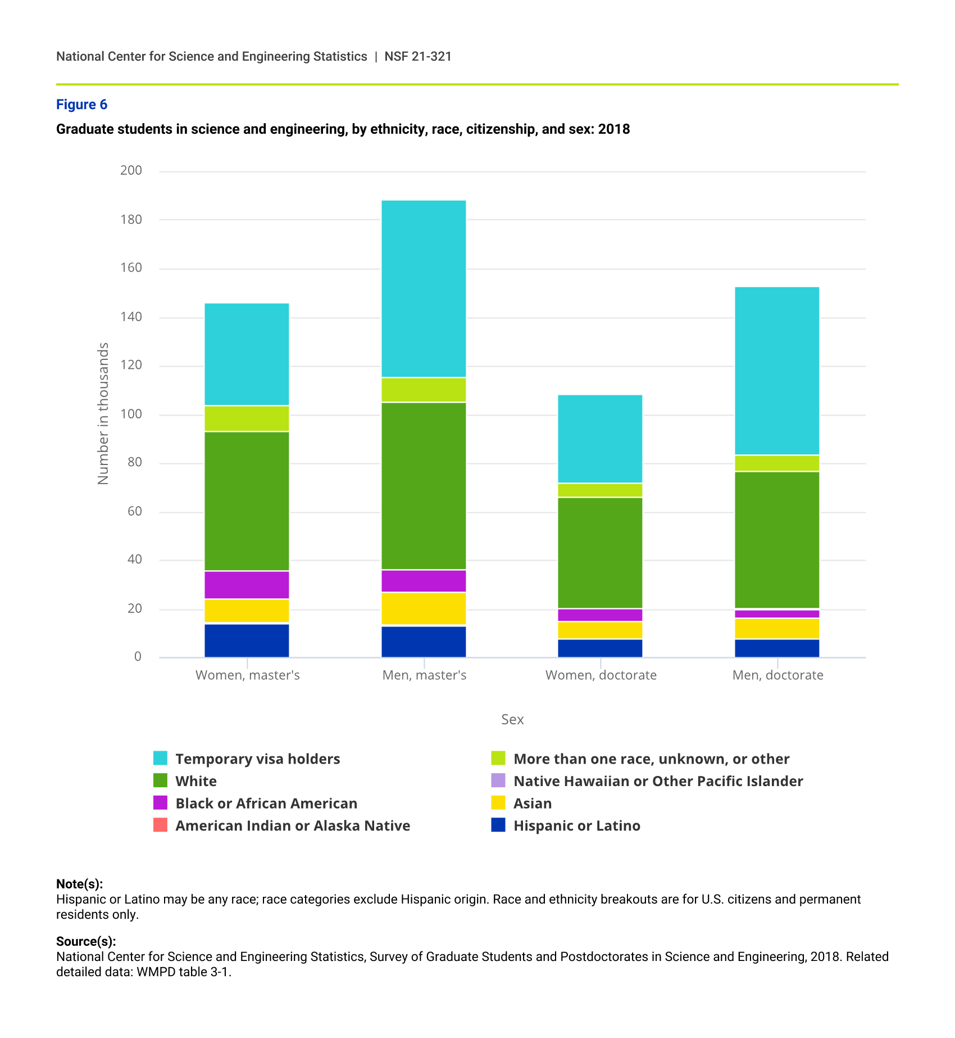
Graduate students in science and engineering by ethnicity, race, citizenship and sex, 2018

Slide 38
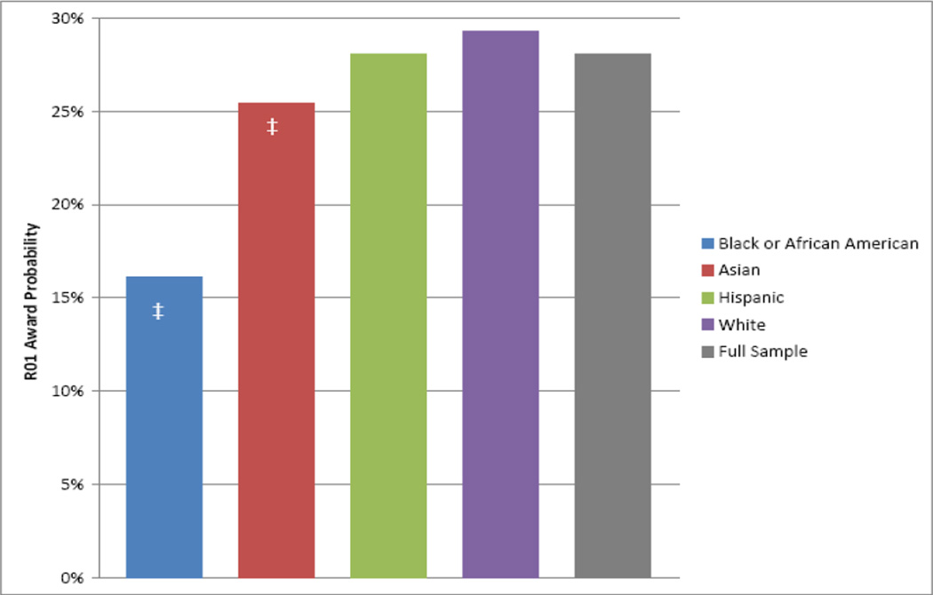
Probability of NIH R01 award by race and ethnicity, FY 2000 to 2006 (N=83,188)
Ginther DK, Schaffer WT, Schnell J, Masimore B, Liu F, Haak LL, Kington R. Race, ethnicity, and NIH research awards. Science. 2011 Aug 19;333(6045):1015-9. doi: 10.1126/science.1196783. PMID: 21852498; PMCID: PMC3412416.

Slide 39
Recent Tufts Survey, 2022
Finding: Sites with higher racial and ethnic diversity among staff saw that diversity reflected in the patients they enrolled
Survey (electronic) sent to international investigative sites running clinical trials
Approximately 40% response rate (n=3187)
Sites with higher diversity also more likely to
  Report they viewed diversity as a critical aspect of success
  Incorporate mission statements, operating procedures, and training programs to reinforce diversity awareness and importance
of what I am capable of doing” Black man
“As a white male, nothing is a given now, you have to fight harder to overcome institutional and government reverse discrimination.” White man
“Hispanics are looked down upon as stupid” Hispanic woman
“The workplace is still geared to the promotion of whites over minorities regardless of the laws in place to promote equality in the workforce.” Hispanic man
https://now.tufts.edu/2021/12/03/increase-diversity-clinical-trials-first-increase-staff-diversity

Slide 40
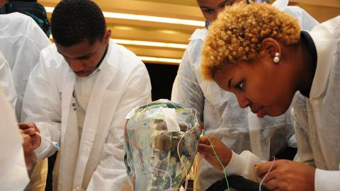
DEI at WRAIR - Current
Science Education and Fellowship Programs
Pre-college
Gains in the Education of Mathematics and Science (GEMS)
High School Apprenticeship Program (HSAP)
College
Near-Peer Mentor (NPM)
Undergraduate Apprenticeship Program (URAP)
Post-Bac and Graduate
ORISE and NRC Fellowships
of what I am capable of doing” Black man
“As a white male, nothing is a given now, you have to fight harder to overcome institutional and government reverse discrimination.” White man
“Hispanics are looked down upon as stupid” Hispanic woman
“The workplace is still geared to the promotion of whites over minorities regardless of the laws in place to promote equality in the workforce.” Hispanic man

Slide 41

DEI at WRAIR – Future Events
Present an all-MRDC DEI webinar (target September 2022)
DRAFT learning objectives
  To provide an understanding of how lack of diversity, equity and inclusion harms the scientific enterprise
  To share programs, initiatives, activities, etc. that can be implemented to improve the DEI, particularly within a scientific employer organization; what ACTION items can be undertaken
of what I am capable of doing” Black man
“As a white male, nothing is a given now, you have to fight harder to overcome institutional and government reverse discrimination.” White man
“Hispanics are looked down upon as stupid” Hispanic woman
“The workplace is still geared to the promotion of whites over minorities regardless of the laws in place to promote equality in the workforce.” Hispanic man

Slide 42
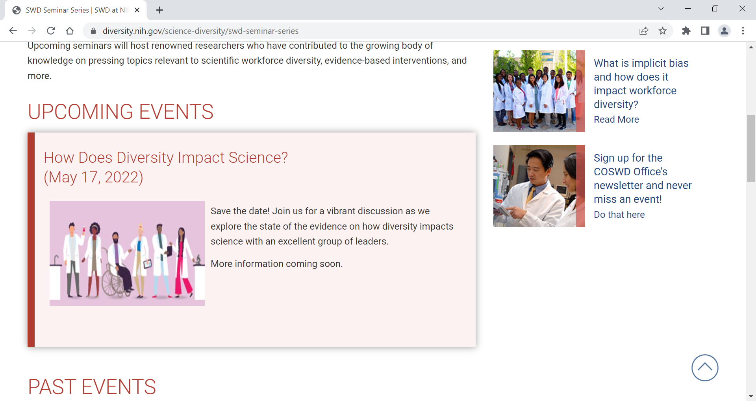
DEI - NIH
https://diversity.nih.gov/science-diversity/swd-seminar-series

Slide 43
Acknowledgements
Special thanks to WRAIR’s Science Education Team and Dr. Sandhya Vasan for use of their slides

Slide 44
References
Boden-Albala, B. (2022). Confronting legacies of underrepresentation in clinical trials: The case for greater diversity in research. Neuron, 110(5), 746-748. https://doi.org/10.1016/j.neuron.2021.12.008
https://www.fda.gov/news-events/press-announcements/fda-takes-important-steps-increase-racial-and-ethnic-diversity-clinical-trials
Ginther, D. K., Schaffer, W. T., Schnell, J., Masimore, B., Liu, F., Haak, L. L., & Kington, R. (2011). Race, ethnicity, and NIH research awards. Science, 333(6045), 1015-1019. https://doi.org/10.1126/science.1196783
Gray II, D. M., Nolan, T. S., Gregory, J., & Joseph, J. J. (2021). Diversity in clinical trials: an opportunity and imperative for community engagement. The Lancet: Gastroenterology & Hepatology, 6(8), 605-607. https://doi.org/10.1016/S2468-1253(21)00228-4
Heinz, K. (2021, October 21). What does DEI mean in the workplace? Built In. https://builtin.com/diversity-inclusion/what-does-dei-mean-in-the-workplace
Hunt, V., Layton, D., & Prince, S. (2015, January 1). Why diversity matters. McKinsey & Company. https://www.mckinsey.com/business-functions/people-and-organizational-performance/our-insights/why-diversity-matters

Slide 45
References
Racial diversity and discrimination in the U.S. STEM workforce. (2019, December 31). Pew Research Center’s Social & Demographic Trends Project. https://www.pewresearch.org/social-trends/2018/01/09/blacks-in-stem-jobs-are-especially-concerned-about-diversity-and-discrimination-in-the-workplace/
Redmond, K. (2014). Why is diversity important for science? Society of Physics Students. https://www.spsnational.org/the-sps-observer/fall/2014/why-diversity-important-science
STEM jobs see uneven progress in increasing gender, racial and ethnic diversity. (2021, April 1). Pew Research Center Science & Society. https://www.pewresearch.org/science/2021/04/01/stem-jobs-see-uneven-progress-in-increasing-gender-racial-and-ethnic-diversity/
Swartz, T. H., Palermo, A. S., Masur, S. K., & Aberg, J. A. (2019). The science and value of diversity: Closing the gaps in our understanding of inclusion and diversity. The Journal of Infectious Diseases, 220(Supplement_2), S33-S41. https://doi.org/10.1093/infdis/jiz174
Walter Reed Army Institute of Research. (n.d.). Science Education and Fellowship Programs. https://www.wrair.army.mil/science-education-and-fellowship-programs

