Slide 1
Rupali J. Limaye, PhD, MPH, MA
Deputy Director,
International Vaccine Access Center
Departments of International Health,
Epidemiology, and Health, Behavior & Society
COVID-19 vaccine confidence: How should we communicate to reduce vaccine hesitancy?

Slide 2
What is the current situation in the US?

Slide 3
65.8% of eligible population in US (12+) is partially vaccinated
57% of eligible population in US (12-17) is fully vaccinated
27% of eligible population in US (5-11) is fully vaccinated
Trials ongoing for children aged 6 months-4 years

Slide 4
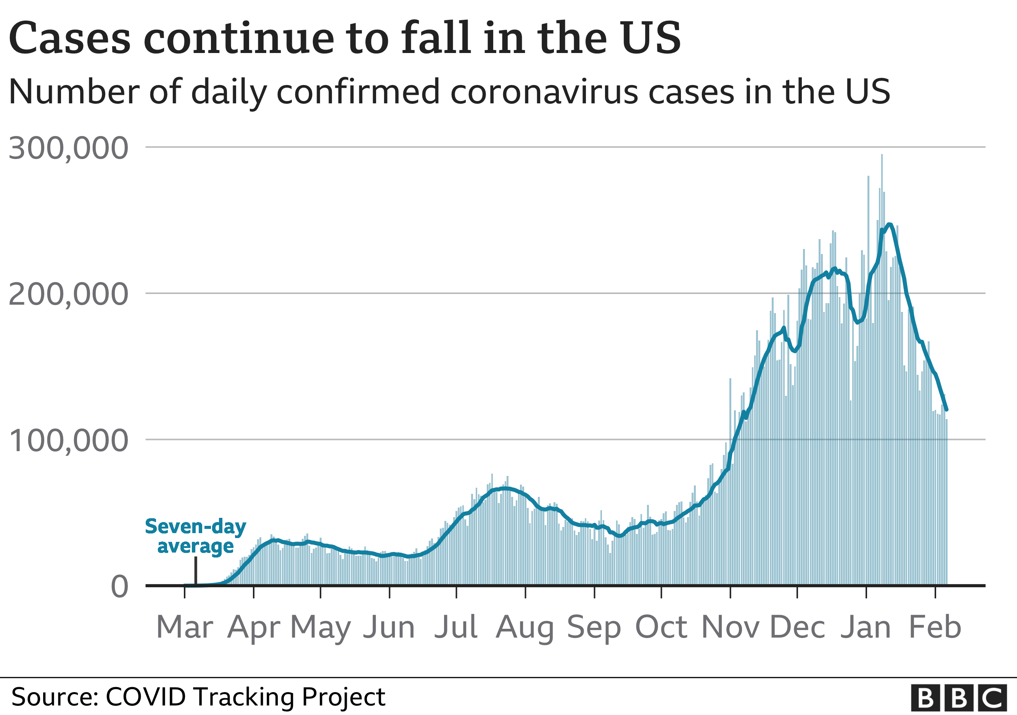

Slide 5
What is driving COVID-19 hesitancy?

Slide 6
Vaccine hesitancy drivers:
Pre-COVID
Vaccine ingredients
Vaccine schedule
Misperception of link between vaccines and severe adverse events (i.e., autism)
Low levels of risk perception
Credit: DOUG CHAYKA

Slide 7
COVID-19 vaccine hesitancy drivers
Distrust and lack of confidence
Misinformation/ disinformation
Polarization

Slide 8
Distrust and lack of confidence
Holding Q & As with African Methodist Episcopalian Zion congregations
Over the last 12 months, have met with 50 congregations in the mid-Atlantic (MD, VA, PA, NY, WV, DE, NC)
30-60 members in each meeting (n~2,500)
Key concerns:
Distrustful of the vaccine development process (timing, recruitment of participants)
Distrustful of health care system due to history of medical experimentation
Lack of confidence: “Is the vaccine safe for Black people?”
Lack of confidence related to safety of the vaccine and other co-morbidities

Slide 9
Distrust and lack of confidence
Holding Q & As with non-profits that serve incarcerated populations
Over the last 12 months, have met with 6 groups of incarcerated populations (NY, PA)
Approximately 20 people in each meeting (either Hispanic and African American; n~100)
Key concerns:
Distrustful of the vaccine development process (timing, recruitment of participants)
Distrustful of health care system due to history of medical experimentation
Lack of confidence: concerns about efficacy of the vaccine itself

Slide 10
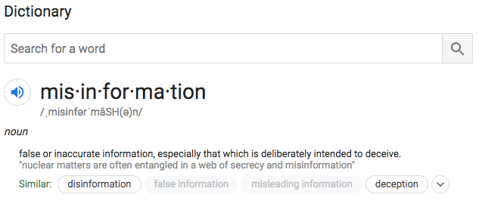
Misinformation/Disinformation
When people spread misinformation, they often believe the information they are sharing
Disinformation is crafted and disseminated with the intent to mislead others
Example: If a political leader claims that COVID-19 is no worse than the flu, despite knowing otherwise, that is disinformation. When an individual hears this, believes it, and then shares it, that is misinformation.

Slide 11
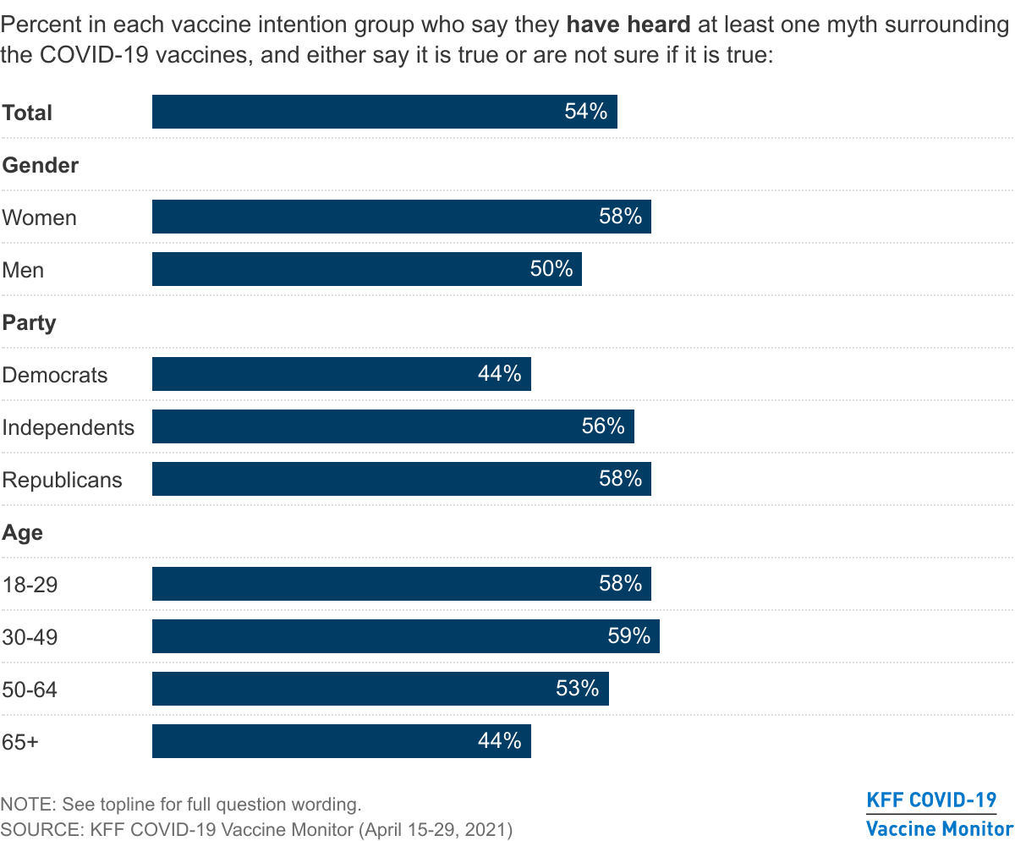
Misinformation & myths

Slide 12
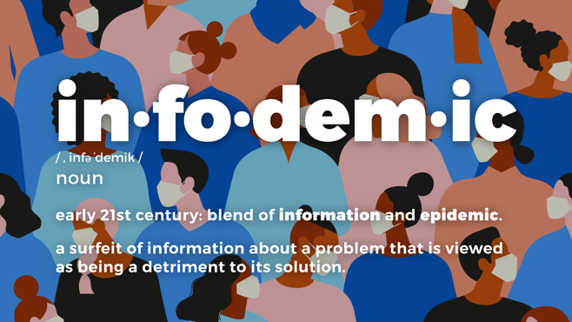
Pandemic + overload of information = infodemic
Public health measures have been accompanied by a massive flow of COVID-19 information, misinformation, and disinformation
We are concurrently inundated with a global epidemic of misinformation, or an infodemic, primarily being spread through social media
Limaye, R. J., Sauer, M., Ali, J., Bernstein, J., Wahl, B., Barnhill, A., & Labrique, A. (2020). Building trust while influencing online COVID-19 content in the social media world. The Lancet Digital Health, 2(6), e277-e278.

Slide 13
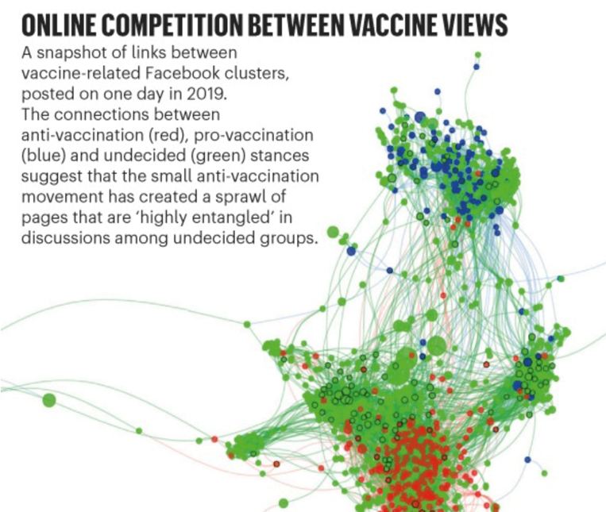
Polarization of attitudes
Schmidt, A. L., Zollo, F., Scala, A., Betsch, C., & Quattrociocchi, W. (2018). Polarization of the vaccination debate on Facebook. Vaccine, 36(25), 3606-3612.

Slide 15
What evidence-based approaches should providers use
to reduce hesitancy?

Slide 16
Although trust in health care providers has been declining, health care providers remain the most trusted advisor and influencer of health decisions, including vaccine decisions.

Slide 17
Giving a strong and personalized recommendation
A strong recommendation includes:
communication related to the importance of the vaccine
encouraging same-day vaccination
timeliness, strength of recommendation, and consistency
provider discusses his/her own decision-making process regarding adult/childhood vaccines
Limaye, R. J., Opel, D. J., Dempsey, A., Ellingson, M., Spina, C., Omer, S. B., ... & Leary, S. O. (2021). Communicating With Vaccine-Hesitant Parents: A Narrative Review. Academic pediatrics, 21(4), S24-S29.

Slide 18
Using presumptive format to initiate the vaccine conversation
This format linguistically presupposes that the person will vaccinate (eg, "So she's due for several vaccines today") and therefore frames vaccination as the default, or normative behavior
Limaye, R. J., Opel, D. J., Dempsey, A., Ellingson, M., Spina, C., Omer, S. B., ... & Leary, S. O. (2021). Communicating With Vaccine-Hesitant Parents: A Narrative Review. Academic pediatrics, 21(4), S24-S29.

Slide 19
Use nudges/defaults: apply presumptive communication.
Omer, S. B., Amin, A. B., Limaye, R. J. (2017). Communicating about Vaccines in a "Post-Fact" World. JAMA Pediatrics, 171 (10), 929-930.
Credit: CDC

Slide 20
Nudging through motivational interviewing
For those with significant questions or concerns about vaccination, more nuanced communication techniques may be needed.
Focuses on leveraging an individual's intrinsic motivation for doing or not doing certain health behaviors and uses tools such as:
active listening
Reflections
open-ended questions
asking permission to provide additional information
acknowledging autonomy as a means to strengthen the perception that the clinician and patient are working together toward a common goal
Limaye, R. J., Opel, D. J., Dempsey, A., Ellingson, M., Spina, C., Omer, S. B., ... & Leary, S. O. (2021). Communicating With Vaccine-Hesitant Parents: A Narrative Review. Academic pediatrics, 21(4), S24-S29.

Slide 21
Enhancing salience through tailoring
Tailoring includes matching each individual's specific beliefs, attitudes, and experiences to the messages or information they are provided, thus improving the personal relevance of the information, and the likelihood that it will change behavior
Limaye, R. J., Opel, D. J., Dempsey, A., Ellingson, M., Spina, C., Omer, S. B., ... & Leary, S. O. (2021). Communicating With Vaccine-Hesitant Parents: A Narrative Review. Academic pediatrics, 21(4), S24-S29.

Slide 22
3 Communication Techniques for Vaccine Conversations
https://www.youtube.com/watch?v=wqBcRE4bZXo&t=4s

Slide 23
Using pre-bunking & inoculation
Strong initial beliefs are more effectively immunized against persuasion by pre-exposing a person to counterarguments
Just as the administration of a weakened dose of a virus (the vaccine) triggers antibodies in the immune system to fight off future infection, pre-emptively exposing people to weakened examples of common techniques that are used in the production of fake news would generate ‘mental antibodies’.
If enough individuals are immunized, the informational ‘virus’ won’t be able to spread.
Papageorgis, D., & McGuire, W. J. (1961). The generality of immunity to persuasion produced by pre-exposure to weakened counterarguments. The Journal of Abnormal and Social Psychology, 62(3), 475.

Slide 24
Using the availability heuristic
The availability heuristic describes our propensity to estimate the probability of an event based on how easily an instance of that event comes to mind.
Omer, S. B., Amin, A. B., Limaye, R. J. (2017). Communicating about Vaccines in a "Post-Fact" World. JAMA Pediatrics, 171 (10), 929-930.

Slide 25
Being careful to not correct misperceptions
Don’t correct misperceptions: The instinctive response to vaccine-related misinformation is to provide correct information, but this can backfire – called the boomerang effect.
Omer, S. B., Amin, A. B., Limaye, R. J. (2017). Communicating about Vaccines in a "Post-Fact" World. JAMA Pediatrics, 171 (10), 929-930.

Slide 26
In 2002, the US Centers for Disease Control and Prevention (CDC) published the Crisis and Emergency Risk Communication (CERC)

Slide 27
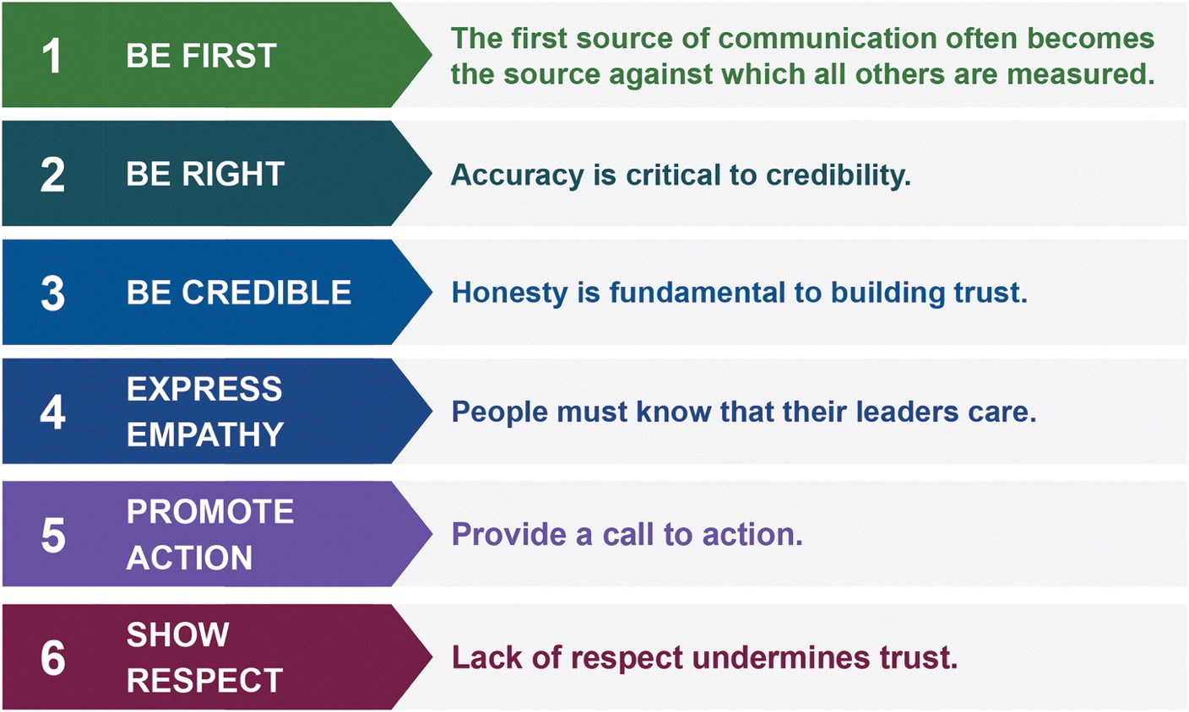
Distrust and lack of confidence

Slide 28
Thank you!

